Slide 1
VMware vSphere 6 What’s New
Cloud Infrastructure and Management 2015 Launch: Technical Overview
Notes:
vSphere 6.0, the industry leading virtualization platform, empowers users to virtualize scale-up and scale-out applications with confidence, redefines availability, and simplifies the virtual data center. The result is a highly available, resilient, on-demand infrastructure that is the ideal foundation for any cloud environment.

Slide 2
Agenda
1 | vSphere Platform Features
2 | vCenter Server Features
3 | vSphere Networking
4 | vSphere Storage and Availability

Slide 3
vSphere 2015 Platform Features

Slide 4
Platform Features - Increased vSphere Maximums
vSphere 5.5 | vSphere 6.0
32 Hosts per Cluster | 64 Hosts per Cluster
4000 Virtual Machines per Cluster | 6000 Virtual Machines per Cluster
320 CPUs | 480 CPUs
4 TB RAM | 12 TB RAM
512 Virtual Machines per Host | 1000 Virtual Machines Per Host
Notes:
We’ve increased the maximums again with this release.
vSphere 6 clusters can now support 64 hosts with 6000 virtual machines. This is up from 32 hosts and 4000 virtual machines.
vSphere 6 Hosts can now support 480 physical CPU’s and 12 TB of RAM, each host can now also support up to 1000 virtual machines.
Use Case:
Hadoop/Big Data Workloads
Scale-out applications will see greater consolidation ratios and improved performance with larger cluster sizes and greater virtual machine densities
vSphere Big Data Extensions simplifies and automates the process of provisioning and configuring production Hadoop clusters

Slide 5
Platform Features - Virtual Machine Compatibility ESXi 6
(vHW 11)
ESXi 6 Supports:
128 vCPUs
4 TB RAM
Hot-add RAM now vNUMA aware
WDDM 1.1 GDI acceleration features
xHCI 1.0 controller compatible with OS X 10.8+ xHCI driver
Serial and parallel port enhancements
  A virtual machine can now have a maximum of 32 serial ports
  Serial and parallel ports can now be removed
Notes:
With 128 vCPUs and 4 TB of RAM, vSphere 6 is capable of virtualizing even the most demanding applications.
Complete vNUMA support, including hotplug support. Currently, hot-add memory only gets added to region 0. This is changed to distributed the newly added memory according to the numa architecture.
WDDM 1.1 - Hardware acceleration of operations helps reduce memory footprint in Windows, because the Desktop Window Manager compositing engine no longer needs to keep a system memory copy of all surfaces used by GDI/GDI+, as it did in WDDM 1.0. WDM 1.1 is supported on Windows 7 and above.
xHCI 1.0 allows USB 3 devices to run at full speed.
Many customers wish to remove all unused devices from virtual machines, utilizing vHW11 customers can now remove serial and parallel ports. In addition customers can now add up to 32 serial ports to a virtual machine.
Use Case:
Business-Critical Applications (e.g. Oracle, SQL Server, Exchange, SAP HANA)
Virtualized scale-up applications will see greater performance as a result of the increased scale and configuration maximums
In virtualized SAP HANA environments, customers have seen 400% performance gains over RDBMS and 9x gains in planning load times as well as significant CapEx and OpEx savings versus non-virtualized environments. The Increased memory size made it possible to house the SAP HANA’s in- memory database in its entirety

Slide 6
Platform Features - Local ESXi Account and Password Management Enhancements
New ESXCLI Commands
Account Lockout
Complexity Rules via Advanced Settings
Now possible to use ESXCLI commands to:
  Create a new local user
  List local user accounts
  Remove local user account
  Modify local user account
  List permissions defined on the host
  Set / remove permission for individual users or user groups
Two Configurable Parameters
  Can set the maximum allowed failed login attempts (10 by default)
  Can set lockout duration period (2 minutes by default)
Configurable via vCenter Host Advanced System Settings
Available for SSH and vSphere Web Services SDK
DCUI and Console Shell are not locked
No editing of PAM config files on the host required anymore
Change default password complexity rules using VIM API
Configurable via vCenter Host Advanced System Settings
Notes:
There are a bunch of enhancements to ESXi account management.
New ESXCLI Commands:
- CLI interface for managing ESXi local user accounts and permissions
- Coarse grained permission management
- ESXCLI can be invoked against vCenter instead of directly accessing the ESXi host.
- Previously, the account and permission management functionality for ESXi hosts was available only with direct host connections.
The help for these ESXCLI commands has more details.
The help can be seen by running the command with the option "--help".
Password Complexity:
Previously customers had to manually edit by hand the file /etc/pam.d/passwd, now they can do it from VIM API OptionManager.updateValues().
Advanced options can also be accessed through vCenter, so there is not need to make a direct host connection.
PowerCLI cmdlet allows setting host advanced configuration options
Account Lockout:
Security.AccountLockFailures - "Maximum allowed failed login attempts before locking out a user's account. Zero disables account locking.”
Default: 10 tries
Security.AccountUnlockTime - "Duration in seconds to lock out a user's account after exceeding the maximum allowed failed login attempts.”
Default: 2 minutes
Takeaways: While it’s still preferred that you
1. limit who can access ESXi
2. limit what they can do when they access ESXi (via Roles and Permissions)
3. treat logging into ESXi as a break-glass scenario
there will still be cases where a customer can’t use AD and must use local accounts. These changes make managing the policies of these local accounts much easier.
What major customer pain points have been handled/fixed/addressed
Local User management capabilities enhanced
Easier management of password policies for local users (AD user password policies not affected. They are managed by AD)
What new capabilities are introduced and what do they do
Account lockout
Aforementioned password policies
What business issues are now handled better
Easier compliance to local security policies

Slide 7

Platform Features - Improved Auditability of ESXi Admin Actions
Prior to 6.0, actions taken at the vCenter level by a named user would show up in ESXi logs with the “vpxuser” username.
  [user=vpxuser]
  This made for difficult forensic tracking of user actions.
In 6.0, all actions taken at vCenter against an ESXi server now show up in the ESXi logs with the vCenter username
  [user=vpxuser:CORP\Administrator]
Notes:
This is a quick one. Prior to V6.0 when an administrator ran an action from vCenter against an ESXi server, the administrators username would not be logged in the ESXi logs. The action would be logged as “vpxuser”.
In V6.0 the username that the administrator is logged into vCenter as will now be included in the logs of the action that runs on ESXi.
See the examples in the slides.
Key Takeaway: This has been done in order to provide better forensics and auditing. Now all actions, including parent actions taken on vCenter and child actions run on ESXi hosts for user CORP\MFOLEY (for example) can be tracked in Log Insight and other logging solutions. Matching usernames to actions provides accountability, auditing and forensics and is a key requirement of compliance objectives.
What major customer pain points have been handled/fixed/addressed
The ability to track all actions of users has been fixed
What new capabilities are introduced and what do they do
No “net new” capabilities
What business issues are now handled better
Easier compliance to security policies

Slide 8
Platform Features - Enhanced Microsoft Clustering (MSCS)
Following MSCS Capabilities Available:
Support for Windows 2012 R2 and SQL 2012
  Failover Clustering and AlwaysOn Availability Groups
IPV6 Support
PVSCSI and SCSI controller support
vMotion Support
  Clustering across physical hosts (CAB) with Physical Compatibility Mode RDM’s
  Supported on Windows 2008, 2008 R2, 2012 and 2012 R2
Notes:
With this release we build on the enhancements made in vSphere 5.5.
We’ve added support for Windows 2012 R2 and SQL 2012 running both in failover cluster mode as well as utilizing AlwaysOn Availability Groups.
IPV6 is now supported.
Users can now use our faster PVSCSI adapter when uses MSCS.
And we introduce vMotion support. It is now supported to vMotion MSCS virtual machines when using Windows 2008 and newer OS’s that are clustered across physical hosts using physical RDM’s.
Use Case:
Customers who require pure IPV6 support can now virtualize MSCS on vSphere
Virtual machines running MSCS are no longer required to run on a single host, vMotion support allows vSphere DRS to place the MSCS virtual machines in the vSphere cluster depending on their needs.
Performance, the PVSCSI adapter provides superior performance over the standard SCSI adapter.

Slide 9
vCenter Server 6.0 Features

Slide 10
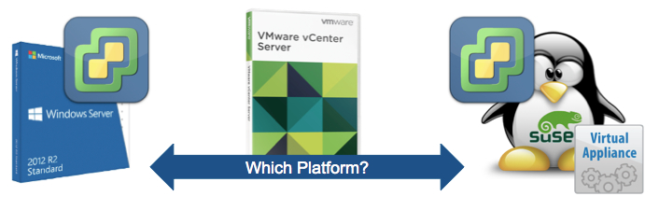
vCenter Server Features - Enhanced Capabilities
Scalability supported by both Windows Install and vCenter Server appliance.
Windows install supports Postgres and External SQL and Oracle DBs.
vCSA supports embedded Postgres and external Oracle DBs.
Metric | Windows | Appliance
Hosts per VC | 1,000 | 1,000
Powered-On VMs per VC | 10,000 | 10,000
Hosts per Cluster | 64 | 64
VMs per Cluster | 6,000 | 6,000
Linked Mode | ✔ | ✔
Notes:
Both the classic Windows installation and the vCenter Server appliance support all the new vCenter Server 6 scale numbers.
There is no longer a difference in scale between Windows and the Appliance!
Windows installs support embedded Postgres, external SQL, and external Oracle Databases. Full scale is still supported when running the embedded Postgres database.
The Appliance supports embedded Postgres or external Oracle Databases. Full scale is still supported when running the embedded Postgres database.
Use Case:
Customers can now deploy the version that makes sense for their business without worrying about sacrificing stability or scalability.
Customers can begin to move to the Appliance at their own pace while still having full interoperability between the Windows and Appliance vCenter Servers.

Slide 11
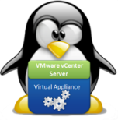

vCenter Server 6.0 – Platform Services Controller
Platform Services Controller includes takes it beyond just Single Sign-On. It groups:
Single Sign-On (SSO)
Licensing
Certificate Authority
Platform Services Controller
Two Deployment Models:
  Embedded
    vCenter Server and Platform Services Controller in one virtual machine
      - Recommended for small deployments where there is less then two SSO integrated solutions
  Centralized
    vCenter Server and Platform Services Controller in their own virtual machines
      - Recommended for most deployments where there are two or more SSO integrated solutions
vCenter
PSC
vCenter
Notes:
The Platform Services Controller (PSC) includes common services that are used across the suite.
These include SSO, Licensing and the VMware Certificate Authority (VMCA)
The PSC is the first piece that is either installed or upgraded. When upgrading a SSO instance becomes a PSC.
There are two models of deployment, embedded and centralized.
Embedded means the PSC and vCenter Server are installed on a single virtual machine. – Embedded is recommended for sites with a single SSO solution such as a single vCenter.
Centralized means the PSC and vCenter Server are installed on different virtual machines. – Centralized is recommended for sites with two or more SSO solutions such as multiple vCenter Servers, vRealize Automation, etc. When deploying in the centralized model it is recommended to make the PSC highly available as to not have a single point of failure, in addition to utilizing vSphere HA a load balancer can be placed in front of two or more PSC’s to create a highly available PSC architecture.
The PSC and vCenter servers can be mixed and matched, meaning you can deploy Appliance PSC’s along with Windows PSC’s with Windows and Appliance based vCenter Servers. Any combination uses the PSC’s built in replication.
Use Case:
The PSC removes services from vCenter and makes them centralized across the vCloud Suite.
This gives customers a single point to manage all their vSphere roles and permissions along with licensing.
Reducing vCenter Server installation complexity allows customers to install or upgrade to vSphere 6 faster.
There are only two installs options:
Embedded PSC which installs all components on al single virtual machine
Centralized, the customer must install the PSC and vCenter Server separately
In either installation model all vCenter Server services are installed on the vCenter Server reducing the complexity of planning and installing vCenter Server.
vSphere Update Manager (VUM) is the only stand-alone product installer.

Slide 12
vCenter Server 6.0 – Linked Mode Comparison
 | vSphere 5.5 | vSphere 6.0
Windows | Yes | Yes
Appliance | No | Yes
Single Inventory View | Yes | Yes
Single Inventory Search | Yes | Yes
Replication Technology | Microsoft ADAM | Native
Roles & Permissions | Yes | Yes
Licenses | Yes | Yes
Policies | No | Yes
Tags | No | Yes
Notes:
Linked mode in previous versions was restricted to the Windows installation of vCenter Server only. This is no longer the case in vSphere 6.
By using the PSC’s built in replication Windows and Appliance based vCenter Servers joined to the same SSO domain will be in vSphere 6 enhanced linked mode. Yes, the Appliance and Windows based vCenter Servers will be in enhanced linked mode simply by joining the same SSO domain.
This differs from what we had previously when pointing vCenter Servers at the same SSO server, in that scenario we only had a single pane of glass view, with vSphere 6 enhanced linked mode we have full replication of roles and permissions, licensing, tags, and policies.
Use Case:
Enhanced Linked Mode Delivers a simple and efficient way to manage your virtual data center.
Customers have a single pane of glass for managing all vCenter Server instances along with roles and permissions and licensing across both Windows and Appliance based deployments.

Slide 13
vCenter Server 6.0 - Certificate Lifecycle Management for vCenter and ESXi
New vCenter Server solutions for complete certificate lifecycle management:
VMware Certificate
Authority (VMCA)
  Provisions each ESXi host, each vCenter Server and vCenter Server service with certificates that are signed by VMCA
VMware Endpoint
Certificate Service (VECS)
  Stores all certificates and private keys for vCenter Server and vCenter Server services
  Managing VECS is done via vecs-cli
    While you can decide not to use VMCA in your certificate chain, you must use VECS to store all certificates, and keys for vCenter Server and services.
    All ESXi certificates are stored locally on the host.
Notes:
This slide introduces the two new components of certificate management.
The VMware certificate authority also known as VMCA and the VMware endpoint certificates services also known as VECS.
One of the key things to remember is that certificates are now stored within VECS and no longer stored in the filesystem of vCenter. Even if you are using third party certificates you will still need to store them in VECS.
For ESXi the certificates are still stored locally on the host this has not changed.
VMCA provisions each vCenter server and Service with certificates that are signed by VMCA. We will go into further detail in the next couple of slides.
Key take away: VMCA and VECS provide a common platform for managing certificates
What major customer pain points have been handled/fixed/addressed
Certificate management
What new capabilities are introduced and what do they do
VMCA certificate authority. See above
VECS certificate storage. See above
What business issues are now handled better
Compliance with security policies

Slide 14
vCenter Server 6.0 - VMCA
Dual Operational Mode
Root CA
During installation, VMCA automatically creates a self-signed certificate
Issuer CA
Can replace the default self-signed CA certificate created during installation
Requires a CSR issued from VMCA to be used in an Enterprise/Commercial CA to generate a new Issuing Certificate
This is a CA certificate, capable of issuing other certificates
All solutions and endpoint certificates are created (and trusted) from this self-signed CA certificate
Requires replacement of all issued default certificates after implementation
Notes:
VMCA can operate in two modes:
Root CA: VMCA is initialized with a self signed certificate. This is a similar form of certificate that the old vCenter 5.x solutions created for themselves, except those were not CA certs. It is normal practice that a CA will have a self-signed certificate at the root, especially if is the first one created in a new domain.
Issuer CA: An Enterprise CA signs the Certificate Signing Request (CSR) that the VMCA generates and the administrator configures VMCA to use this certificate and keys.
Takeaways: you should understand the two modes of operation for VMCA.
When used as a root certificate authority VMCA uses a self signed root certificate. Installation of that root certificate can be put on browsers and other endpoints to avoid additional dialog boxes.
When using VMCA the issuer certificate authority mode a signing certificate is created on the root certificate authority and installed on VMCA. VMCA can now issue certificates that are trusted up to the root certificate authority.
------------
What major customer pain points have been handled/fixed/addressed
Certificate management
What new capabilities are introduced and what do they do
VMCA certificate authority. Use as a Root CA or a subordinate or “Issuer” CA
What business issues are now handled better
Compliance with security policies
Easier management of vSphere certificates

Slide 15
vCenter Server 6.0 - Certificate Replacement Options for vCenter Server
VMCA Default
Default installed certificates
Possible to regenerate these on demand easily
VMCA Enterprise
Replace VMCA CA certificates with a new CA certificate from the Enterprise PKI
On removal of the old VMCA CA certificate, all old certificates must be regenerate
Custom
Disable VMCA as CA
Provision custom leaf certificates for each solution, user and endpoint
Self-signed VMCA CA certificate as Root
More complicated, for highly security conscious customers
Notes:
There are three certificate replacement options for vCenter.
When using VMCA In the default mode VMCA Creates a self signed root certificate. These root certificates can be regenerated on demand As necessary.
When using VMCA In enterprise mode VMCA has been issued a signing certificate from the enterprise certificate authority. If you have already used VMCA In default mode and issued certificates from the VMCA root certificate authority and wish to migrate to the enterprise mode then you will need to regenerate all of the old certificates.
When the customer wants to use his own certificate authority or third party certificates then you will be disabling VMCA as the certificate authority for the vCenter. You will manually install the custom certificates for each solution user and endpoint. These certificates will be installed into VECS. Procedures for making this easier are being worked on and will be available after GA.
Key takeaways:
The easiest method is to use VMCA in default mode.
If you’re going to use VMCA in enterprise mode consider planning out those steps and not using VMCA in default mode and migrating from one mode to another.
If your customer Is going to use third party certificates or their own certificate of authority and they don’t want to Issue a signing certificate to VMCA then they should work with GSS to ensure that all steps are correctly done. The certificate replacement steps are very different from version 5.5. As mentioned procedures for making this easier are being worked on and will be available after GA.
What major customer pain points have been handled/fixed/addressed
Certificate management
What new capabilities are introduced and what do they do
VMCA as a Root CA or a subordinate or “Issuer” CA
What business issues are now handled better
Compliance with security policies
Easier management of vSphere certificates
Ability to still use 3rd party certificates if necessary

Slide 16
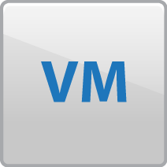


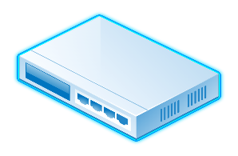
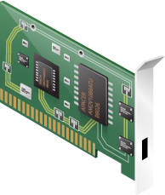
vCenter Server 6.0 - Cross vSwitch vMotion
vCenter Server
Transparent operation to the guest OS
Works across different types of virtual switches
  vSS to vSS
  vSS to vDS
  vDS to vDS
Requires L2 network connectivity
  Does not change the IP of the VM
Transfers vDS port metadata
vMotion
vMotion
Network
vDS A
vDS B
VM Network
(L2 Connectivity)
Notes:
Cross vSwitch vMotion allows you to seamless migrate a VM across different virtual switches while performing a vMotion.
No longer restricted by the network you created on the vSwitches in order to vMotion a virtual machine.
Requires the source and destination portgroups to share the same L2. The IP address within the VM will not change.
vMotion will work across a mix of switches (standard and distributed). Previously, you could only vMotion from vSS to vSS or within a single vDS. This limitation has been removed.
The following Cross vSwitch vMotion migrations are possible:
vSS to vSS
vSS to vDS
vDS to vDS
vDS to VSS is not allowed
Transfers the vDS metadata to the destination vDS (network statistics)
Use Cases:
Datacenter Migrations – Migrate a VM to a new cluster with a separate vDS without interruption.
Business Benefits:
Increased agility
Reducing the time it takes to replace/refresh hardware.
Increased reliability
Increased availability of business applications.
Increased availability during planned maintenance activities.

Slide 17
vCenter Server 6.0 - Cross vCenter vMotion
vCenter Server
vCenter Server
Simultaneously changes
  Compute
  Storage
  Network
  vCenter
vMotion without shared storage
Increased scale
  Pool resources across vCenter servers
Targeted topologies
  Local
  Metro
  Cross-continental
vMotion
vMotion
Network
vDS A
vDS B
VM Network
(L2 Connectivity)
Notes:
Expanding on the Cross vSwitch vMotion enhancement, we are also excited to announce support for Cross vCenter vMotion.
vMotion can now perform the following changes simultaneously.
Change compute (vMotion) - Performs the migration of virtual machines across compute hosts
Change storage (Storage vMotion) - Performs the migration of the virtual machine disks across datastores
Change network (Cross vSwitch vMotion) - Performs the migration of a VM across different virtual switches
and finally…
Change vCenter (Cross vCenter vMotion) - Performs the migration of the vCenter which manages the VM.
All of these types of vMotion are seamless to the guest OS.
Like with vSwitch vMotion, Cross vCenter vMotion requires L2 network connectiviy since the IP of the VM will not be changed.
This functionality builds upon Enhanced vMotion and shared storage is not required.
Target support for local (single site), metro (multiple well-connected sites), and cross-continental sites.
Use Cases:
Migrate from a VCSA to a Windows version of vCenter & vice versa
Replace/retire vCenter server without distruption
Resource pooling across vCenters where additional vCenters were used due to vCenter scalability limits
Migrate VMs across local, metro, and continental distances
Public/Private cloud environments with several vCenters
Business Benefits:
Reduce cost
Migration to a VCSA eliminates Windows and SQL licenses
Increased reliability
Migration to a Windows vCenter with a SQL cluster can increase availability of vCenter services.
Increased availability during planned maintenance activities.
vCenters can be drained and upgraded without impacting managed virtual machines.

Slide 18
vCenter Server 6.0 - Cross vCenter vMotion
Requirements
Features
vCenter 6.0 and greater
SSO Domain
  Same SSO domain to use the UI
  Different SSO domain possible if using API
250 Mbps network bandwidth per vMotion operation
L2 network connectivity on VM portgroups
  IP addresses are not updated
VM UUID maintained across vCenter server instances
  Not the same as MoRef or BIOS UUID
Data Preservation
  Events, Alarms, Tasks History
  HA/DRS Settings
    Affinity/Anti-Affinity Rules
    Automation level
    Start-up priority
    Host isolation response
  VM Resource Settings
    Shares
    Reservations
    Limits
  MAC Address of virtual NIC
MAC Addresses preserved across vCenters
  Always unique within a vCenter
  Not reused when VM leaves vCenter
Notes:
Requirements: There are several requirements for Cross vCenter vMotion to work.
Only vCenter 6.0 and greater will be supported. All instances of vCenter prior to version 6.0 will need to be upgraded before this this feature will work. For example, an instance of vCenter 5.5 and 6.0 will not work.
Both the source and the destination vCenter servers will need to be joined to the same SSO domain if you want to perform the vMotion using the vSphere Web Client. If the vCenter servers are joined to different SSO domains, it’s still possible to perform a Cross vCenter vMotion, but you must use the API.
You will need at least 250 Mbps of available network bandwidth per vMotion operation.
Lastly, although not technically required for the vMotion to successfully complete, L2 connectivity is required on the source and destination portgroups. When a Cross vCenter vMotion is performed, a Cross vSwitch vMotion is done as well. The virtual machine portgroups for the VM will need the share an L2 network because the IP will within the guest OS will not be updated.
Features:
These are some of the features with Cross vCenter vMotion.
The VM UUID or VM Instance ID will always remain the same across all vCenter servers in the environment. This is not the same as the Managed ID, MoRef, or BIOS UUID. UUID location is found in the vmx file under the title “vc.uuid”
The historical data and settings for the VM are retained when it’s migrated using Cross vCenter vMotion. This includes Events, Alarms and Task history. Performance data is only kept on the source vCenter server.
Additionally HA/DRS settings that will persist after the vMotion are:
Affinity/Anti Affinity Rules
Automation level
Start-up priority
Host isolation response
These are the resource settings that be migrated:
Resource Settings
Shares
Reservations
Limits
MAC Address are generated in such a way they are guaranteed to be unique to that vCenter server. When a VM is migrated off a vCenter server it will keep the same MAC address at the destination vCenter. Additionally, that MAC address is added to a local blacklist on the source vCenter server to guarantee that server does not reuse that MAC address in case it happens to generate the same MAC for a new VM.

Slide 19
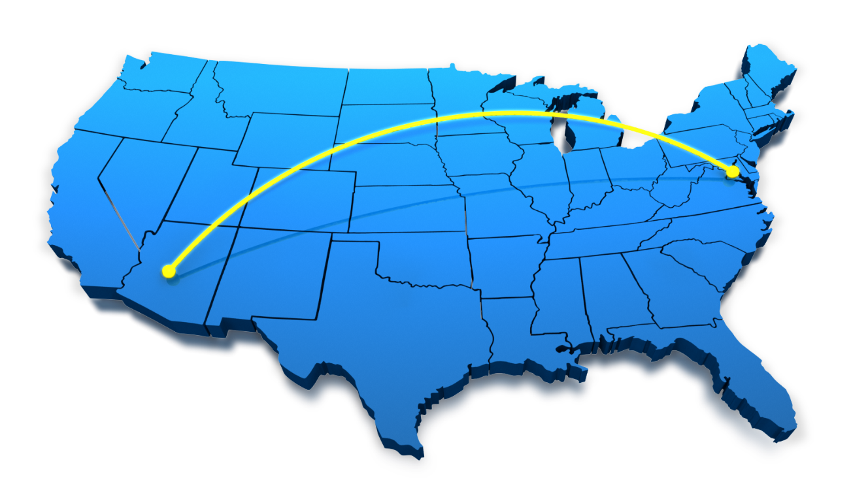
vCenter Server 6.0 - Long Distance vMotion
Cross-continental distances – up to 100ms RTTs
Maintain standard vMotion guarantees
Does not require VVOLs
Use Cases:
  Permanent migrations
  Disaster avoidance
  Multi-site load balancing
  Follow the sun
Notes:
Long Distance vMotion is an extension of Cross vCenter vMotion however targeted for environments where vCenter servers are spread across large geographic distances and where the latency across sites is 100ms or less.
Although spread across a long distance, all the standard vMotion guarantees are honored.
This does not require VVOLs to work. A VMFS/NFS system will work also.
Use Cases:
Migrate VMs across physical servers that spread across a large geographic distance without interruption to applications
Perform a permanent migration for VMs in another datacenter.
Migrate VMs to another site to avoid imminent disaster.
Distribute VMs across sites to balance system load.
Follow the sun support.
Business Benefits:
Increased reliability
Increased availability of business applications.
Increased availability during a disaster avoidance situation.
Requirements:
The requirements for Long Distance vMotion are the same as Cross vCenter vMotion, except with the addition of the maximum latency between the source and destination sites must be 100 ms or less, and there is 250 Mbps of available bandwidth.
To stress the point: The VM network will need to be a stretched L2 because the IP of the guest OS will not change. If the destination portgroup is not in the same L2 domain as the source, you will lose network connectivity to the guest OS. This means in some topologies, such as metro or cross-continental, you will need a stretched L2 technology in place. The stretched L2 technologies are not specified. Any technology that can present the L2 network to the vSphere hosts will work, as it’s unbeknown to ESX how the physical network is configured. Some examples of technologies that would work are VXLAN, NSX L2 Gateway Services, or GIF/GRE tunnels.
There is no defined maximum distance that will be supported as long as the network meets these requirements. Your mileage may vary, but are eventually constrained by the laws of physics.
The vMotion network can now be configured to operate over an L3 connection. More details on this are in the next slide.

Slide 20


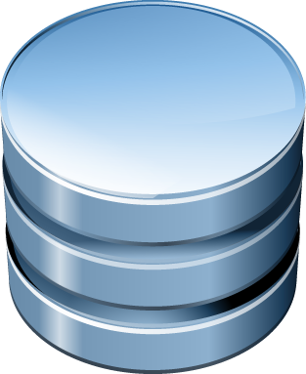

vCenter Server 6.0 - Increased vMotion Network Flexibility
vMotion network will cross L3 boundaries
vMotion can now use it’s own TCP/IP stack
vCenter
vCenter
Management Network
VM
Network
ESXi
ESXi
NFC
Network
vMotion
Network
Notes:
In addition to a multiple network stack, NFC traffic can be isolated from other traffic. This allows operations such as cloning from a template to be sent over a dedicated network rather than sharing the management network as in previous versions. This allows more fine tuned control of network resources.
The next version of ESXi will have multiple TCP/IP stacks.
This allows the vSphere services to operate with their own
Memory Heap
ARP Tables
Routing Table
Default Gateway
Previously ESX had only one networking stack. This improves scalability and offers flexibility by isolating vSphere services to their own stack. This also allows vMotion to work over dedicated Layer 3 network.

Slide 21
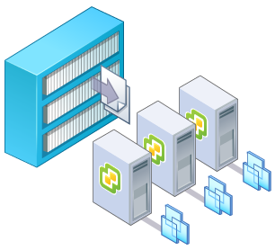
vCenter Server 6.0 - Content Library Overview
Simple content management
  VM templates
  vApps
  ISO images
  Scripts
Store and manage content
  One central location to manage all content
    Beyond templates within vCenter
  Support for other file types
Share content
  Store once, share many times
    Publish/Subscribe
  vCenter -> vCenter
  vCloud Director -> vCenter
Consume content
  Deploy templates to a host or a cluster
Notes:
Many organizations have several vCenters servers across diverse geographic locations, and on these vCenters there is most likely a collection of templates and ISOs. Currently there is function within vCenter to centrally manage the templates and distribute them to all locations. The Content Catalog provides the ability to centrally manage content and ensure it’s distributed across the infrastructure.
vCenter’s Content Library provides simple and effective management for:
VM templates
vApps
ISO images
Scripts
Use Cases:
Centrally manage VM templates
Distribute templates globally
Guarantee identical versions of templates/ISOs are available to all locations
Accomplish automatic VM template lifecycle. New templates are automatically distributed and old templates are deleted.
The Content Library breaks down into three main features. Here is a summary of those features.
Store and manage content
Share content
Consume content
As stated previously, the Content Library provides the ability to store and manage content. This ensures that the latest versions of the templates are available across the infrastructure.
In addition to virtual machine templates, vApp templates, ISO files, and scripts can also be stored within a Content Library.
There are three types of Catalog Libraries
Local Catalog – Local only to the local vCenter
Published Catalog – A local library that is published for catalog subscribers
Subscribed Catalog – A library that syncs with a published library
There are also two types of subscriptions to a published catalog.
Immediate Download (aka Automatic Subscription) – The entire contents of the published catalog are copied to the subscriber.
On-Demand - Instead of downloading all the data at once, only the metadata is downloaded as a reference to the content on the published library. This allows the administrator to download full catalog items only when needed by synchronizing individual items of within the catalog.

Slide 22
vCenter Server 6.0 - Content Library Technical Details
Content Library/Transfer Service are part of the vmware-vdcs service
  Installed on the vCenter Management Node
Content Library information is stored in the vCenter database (VCDB)
  Table prefix cl_
Content Library administrator privileges are required
Single storage type backing the catalog
  If stored on a datastore, 64TB is the maximum size
Maximum of 256 content items per library
Maximum of 10 simultaneous copies
Synchronization occurs once every 24 hours
Notes:
Here are some of the technical details for the Content Library
The Content Library and Transfer service are the main services and are included as part of vmware-vdcs which is the Virtual Datacenter Service that is installed as part of the vCenter Management Node.
The Content Library Service is responsible for keeping track of the metadata of all the Content Libraries it is in charge of as well as checking for updates on a publisher.
The Transfer Service does most of the heavy lifting and is called by the Content Library Service to copy content between libraries
The Content Library also utilizes the same database as vCenter, that is the VCDB.
The information related to the Content Library Service can be seen in tables with the prefix of cl_
vCenter users need to have Content Library Administrator privileges set Globally to fully manage Content Libraries, a subset of these can be applied based on the tasks they need to complete
The Global Permissions have been added in the vSphere 6.0 release and spans across vCenters.
Regardless of the option chosen the Content Library can only be backed by a single filesystemmount or datastore. Its backing can’t be changed after creation.
If this storage is a Datastore, the max supported capacity is 64 Terabytes
Once created, a Content Libraryhas the ability to hold a maximum of 256 pieces of Content
The maximum number of simultaneous syncs or copies that can occur between a subscriber and a publisher is 10. This is not configurable.
Automatic synchronization happens once a day by default but the time and frequency of this is configurable through the API.
The administrator can synchronize an entire Content Library or an individual item at any time through the vSphere Web Client

Slide 23
vCenter Server 6.0 - Clients
Client Comparison
Use case | Web Client | vSphere Client
vSphere management | ✔ | ✔
ESXi/VM patching (VUM) | ✖ | ✔
Hardware version 8-11 | ✔ | ✔*
New features | ✔ | ✖
* v10-11 Read only access
Notes:
The Windows installable vSphere Client now has the ability to manage virtual hardware 10 and 11 virtual machines. Any new feature to virtual hardware 10 and 11 are read only.

Slide 24
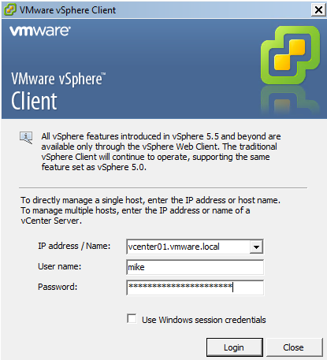
vCenter Server 6.0 - vSphere Client
It’s still here
  Direct Access to hosts
  VUM remediation
  New features in vSphere 5.1 and newer are only available in the web client
Added support for virtual hardware versions 10 and 11 *read only*
Notes:
Yes, the vSphere Client is still here, no major updates.
Use Case:
Direct access to hosts, allows administrators to troubleshoot ESXi in the event vCenter Server is unavailable.
vSphere Update Manager (VUM) remediation. Administrators love VUM and currently the vSphere client is the only way to perform a remediation task.
Able to troubleshoot virtual machines with hardware version 10 and 11, this allows the vCenter Server virtual machine to take advantage of the latest improvements in virtual hardware while still allowing an administrator to have access to the virtual machine for maintenance tasks.

Slide 25
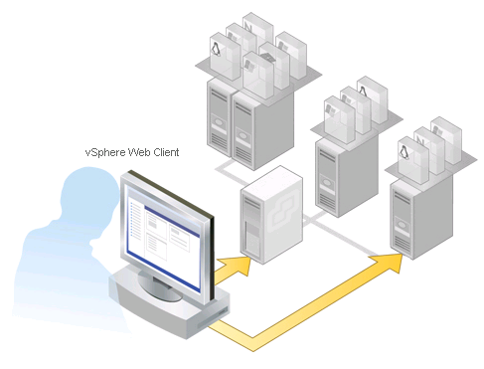
vCenter Server 6.0 - vSphere Web Client
Performance
Improved login time
Faster right click menu load
Faster performance charts
Usability
Recent Tasks moved to bottom
Flattened right click menus
Deep lateral linking
25
Notes:
The vSphere Web Client went through extensive optimization around both performance and usability.

Slide 26
vCenter Server 6.0 - vSphere Web Client Features
Major Performance Improvements:
  UI
    Screen by screen code optimization
    Login now 13x faster
    Right click menu now 4x faster
    Most tasks end to end are 50+% faster
  Performance charts
    Charts are available and usable in less then half the time
  VMRC integration
    Advanced virtual machine operations
Notes:
On the performance side:
Engineering went screen by screen optimizing every query being made back to the Inventory Service, and SSO.
This resulted in 13 times faster login. Right click menus appear and are useable 4 times faster. And most tasks are now at least 50% faster.
Performance charts now render and are usable in less then half the time.
VMRC has also been integrated, now administrators can perform the same actions from a virtual machine console as they did in the Windows client. (performing power operations, adding and removing removable media)
Looking at the chart the blue lines represent the time in milliseconds an operation took in previous web client versions, the red lines represent the time in milliseconds the vSphere 6 web client takes to perform the same actions.
Firefox is still a supported browser but the performance when using it is 3-4 times slower compared to using Chrome or Internet Explorer, DON’T USE FIREFOX.
Use Cases:
The vSphere Web Client is the client going forward. In this release we’ve made significant gains in performance bringing it on-par with the Windows Client.

Slide 27
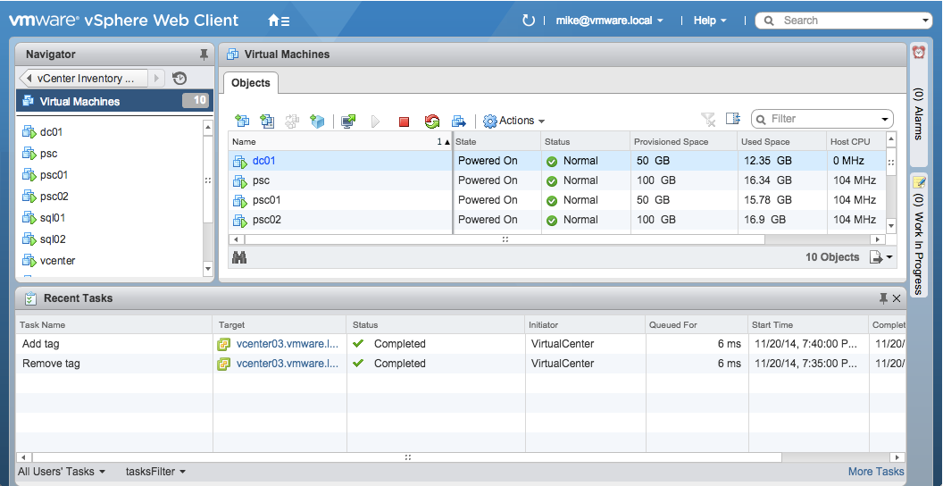
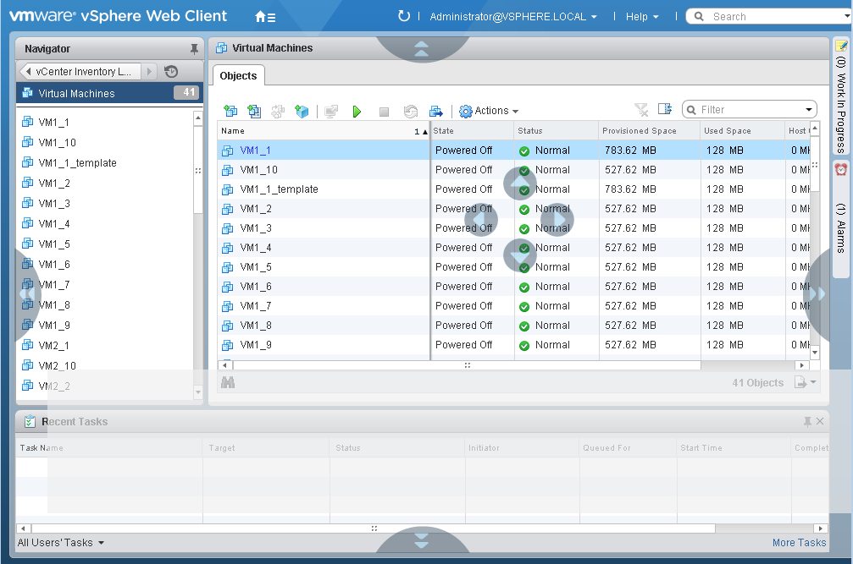
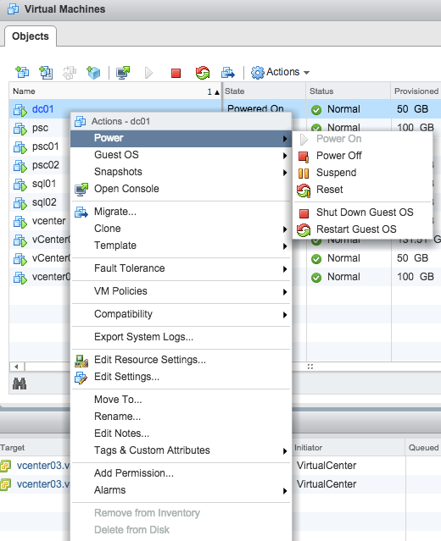
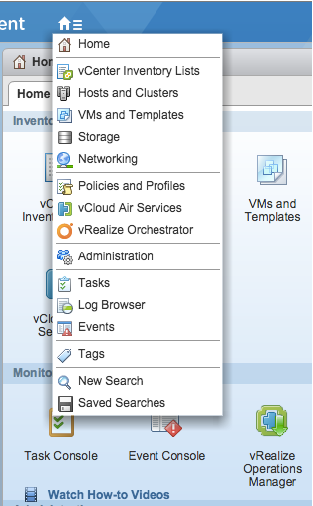
vCenter Server 6.0 - vSphere Web Client
Usability Improvements
  Can get anywhere in one click
  Right click menu has been flattened
  Recent tasks are back at the bottom
  Dockable UI
Notes:
Usability improvements include:
An enhanced “Home” button. Simply hover over it and you can get to any area in the Web Client in a single click.
The Right Click Menu has been flattened and to make getting to where you need as fast and easy as it was in the vSphere Client.
We’ve moved the recent tasks list back to the bottom, allowing for more information to be displayed and a more consistent feel when compared to the vSphere Client.
And lastly the UI is dockable. You can re-arrange your screen layout in anyway you want.
Use Cases:
The vSphere Web Client should be a familiar interface to those who are familiar with the Windows installable client.
The UI improvements allow administrators to get to where they need to go in the interface and perform the tasks they need to much faster.
The key takeaway is the vSphere Web Client is interface we want our customers using, the performance improvements and UI enhancements made will ensure even the most demanding administrators feel comfortable in the interface and notice no performance differences between the Windows and Web Clients.

Slide 28
vSphere 6.0 Networking

Slide 29
vSphere 6.0 - Network I/O Control Version 3
Reserve bandwidth to guarantee service levels
Applied at vNIC level
  Enables bandwidth to be guaranteed at the virtual network interface on a virtual machine
    Reservation set on the vNIC in the virtual machine properties
    Applied at a Distributed Port Group
      Enables bandwidth to be guaranteed to a specific VMware Distributed Switch port group
        Reservation set on the VDS port group
        Enables multi-tenancy on one VDS by guaranteeing bandwidth usage from one tenant won’t impact another
Notes:
Network I/O Control Version 3 allows administrators or service providers to reserve or guarantee bandwidth to a vNIC in a virtual machine or at a higher level the Distributed Port Group.
This ensures that other virtual machines or tenants in a multi-tenancy environment don’t impact the SLA of other virtual machines or tenants sharing the same upstream links.
Use Cases:
Allows private or public cloud administrators to guarantee bandwidth to business units or tenants. ← This is done at the VDS port group level.
Allows vSphere administrators to guarantee bandwidth to mission critical virtual machines. ← This is done at the VMNIC level.

Slide 30
vSphere 6.0 Storage and Availability

Slide 31
VMware Virtual Volumes

Slide 32
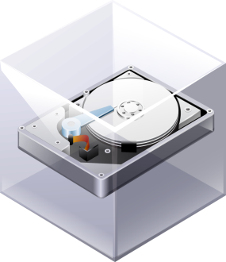



vSphere 6.0 – VMware Virtual Virtual Volumes
Ability to express application (VM/VMDK) granular data services
Provide easy on-demand Capacity provisioning
Compliance Monitoring
Ability to get most out of the storage system
VI admin
Easy Capacity management
Meet VM SLOs
Access Control and Security
Storage admin
Notes:
Simply put, the goal of Virtual Volumes is to bring the benefits of the SDDC to storage. For the vSphere Admin, Virtual Volumes enables on-demand access to exactly the right kind of storage and storage services needed for applications, and for the storage admin it provides a more efficient way to provision and manage storage for vSphere environments.

Slide 33

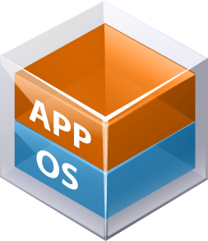












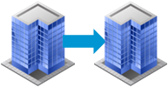

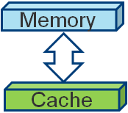
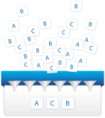

vSphere 6.0 – Virtual Volumes
External Storage Architectures
Without Virtual Volumes
With Virtual Volumes
vSphere
vSphere
Provides Per-VM Granularity
Offloaded Data Services
datastore a
Policy based Management
AND
LUN
LUN
Eliminates LUN Management
LUN
LUN
LUN
Array-a
Array-b
Replication
Snapshots
Caching
Encryption
De-duplication
Notes:
Vvols changes the way storage is architected and consumed. Using external arrays without Vvols, typically the LUN is the unit of both capacity and policy. In other words, you create LUNs with fixed capacity and fixed data services. Then, VMs are assigned to LUNs based on their data service needs. This can result in problems when a LUN with a certain data service runs out of capacity, while other LUNs still have plenty of room to spare. The effect of this is that typically admins overprovision their storage arrays, just to be on the safe side.
With Vvols, it is totally different. Each VM is assigned its own storage policy, and all VMs use storage from the same common pool. Storage architects need only provision for the total capacity of all VMs, without worrying about different buckets with different policies. Moreover, the policy of a VM can be changed, and this doesn’t require that it be moved to a different LUN.

Slide 34
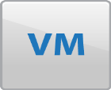















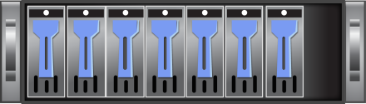
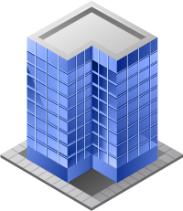


vSphere 6.0 - High Level Storage Architecture
Overview
Storage Policy
Capacity
Performance
No FileSystem
ESX manages array through VASA (vSphere APIs for storage awareness) APIs
Arrays are logically partitioned into containers, called Storage Containers
VM disks, called Virtual Volumes, stored natively on the Storage Containers.
IO from ESX to array is addressed through an access point called Protocol Endpoint (PE)
Data services are offloaded to the array
Managed through storage policy-based management framework
Availability
Data Protection
vSphere
Storage Policy-Based Mgmt.
Security
Virtual Volumes
PE
PE
VASA Provider
Published Capabilities
Snapshot
Replication
Deduplication
Encryption
Notes:
This slide walks through the architecture of Vvols at a high level. Subsequent slides will dive into individual components in a bit more detail.

Slide 35

vSphere 6.0 - VASA Provider (VP)
Characteristics
Software component developed by storage array vendors
ESX and vCenter Server connect to VASA provider
Provides storage awareness services
Single VASA provider can manage multiple arrays
Supports VASA APIs exported by ESX
VASA provider can be implemented within the array’s management server or firmware
Responsible for creating Virtual Volumes
Virtual Volumes
VASA Provider
Notes:
The VASA Provider is the component that exposes the storage services which a Vvols array can provide. It also understands VASA APIs for operations such as the creation of virtual volume files. It can be thought of as the “control plane” element of Vvols. A VASA provider can be implemented in the firmware of an array, or it can be in a separate VM that runs on the cluster which is accessing the Vvols storage (e.g., as a part of the array’s management server virtual appliance)

Slide 36
vSphere 6.0 - Protocol Endpoints (PE)
Why Protocol Endpoints?
Separate the access points from the storage itself
Can have fewer access points
What are Protocol Endpoints?
Access points that enable communication between ESXi hosts and storage array systems.
They are part of the physical storage fabric
Created by storage administrators
Compatible with all SAN and NAS Protocols:
  iSCSI
  NFS v3
  FC
  FCoE
Virtual Volumes
PE
VASA Provider
Notes:
Protocol Endpoints are the channel through which data is sent between the VM’s and the arrays. They can be thought of as the “data plane” component of Vvols. PE’s are configured as a part of the physical storage fabric, and are accessed by standard storage protocols, such as iSCSI, NFS v3, and FC. By having a separate data channel, Vvols performance is not affected by the policy management activities.

Slide 37
vSphere 6.0 - Storage Container (SC)
What are Storage Containers?
  Logical storage constructs for grouping of virtual volumes.
  Setup by storage administrators
    Capacity is based on physical storage capacity
    Logically partition or VM isolation with diverse storage needs and requirement
    Minimum one storage container per array
    Maximum depends on the array
    A single SC can be simultaneously accessed via multiple Protocol Endpoints
vCenter
Virtual Volumes
SC
SC
Notes:
A storage container is a logical construct for grouping Virtual Volumes. It is set up by the storage admin, and the capacity of the container can be defined. As mentioned before, Vvols allows you to separate capacity management from policy management. Containers provide the ability to isolate or partition storage according to whatever need or requirement you may have. If you don’t want to have any partitioning, you could simply have one storage container for the entire array. The maximum number of containers depends upon the particular array model.

Slide 38

vSphere 6.0 - Storage Container (SC)
Do I still need to create Datastores?
vSphere Datastore
Storage Container
Notes:
The main thing to note about storage containers is, a storage container maps to a vSphere Datastore. The concept of datastores is deeply embedded within vSphere and all associated products, and they are used for various purposes, such as administrative access control. Vvols provides a corresponding object so that you can continue to logically manage storage as you do with traditional arrays. Once again, the storage policies do NOT have to be tied to a datastore or storage container.

Slide 39


vSphere 6.0 - Storage Policy Based Management (SPBM) – Array Capabilities
Storage Policy-Based Mgmt.
Virtual Volumes APIs
Sample Default Profile for (6090a058-cd89-ffe3-87763007db37] - capabilities
Disk Types
Disk Encryption
Dedupe
Replication
Snapshot
Disk Types
Disk Encryption
Dedupe
Replication
Snapshot
Publish Capabilities
Array based features and data services
Defines what an Array can offer
Advertised to ESX through VASA APIs
CV
CV
CV
Storage admin
Notes:
Instead of being based on static, per-LUN assignment, storage policies with Vvols are managed through the Storage Policy-Based Management framework of vSphere. This framework uses the VASA APIs to query the storage array about what data services it offers, and then exposes them to vSphere as capabilities. These capabilities can then be grouped together into rules and rulesets, which are then assigned to VMs when they get deployed. When configuring the array, the storage admin can choose which capabilities to expose or not expose to vSphere.

Slide 40



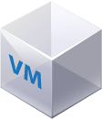
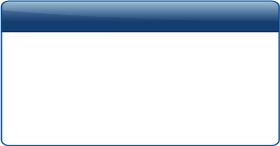
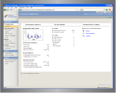

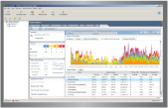




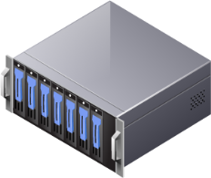
vSphere 6.0 - Virtual Volumes
Storage policies
Datastores
Virtual Machines
vSphere Web Client
What do the admins need to get familiar with?
Storage Management UI
Storage Container
VVol
VVol
VVol
Virtual Volumes
Storage capabilities
Notes:
This picture illustrates two views of Vvols: one from the storage admin and one from the vSphere Admin. As you can see, Vvols provides a way for a storage admin to understand and manage objects that vSphere admins have long used, such as datastores and VM files. Storage policies, on the other hand, provide vSphere Admins with an easy way to consume capabilities that the storage admin has had to up until now keep hidden behind the construct of a “LUN”. It’s a win-win for everyone!

Slide 41
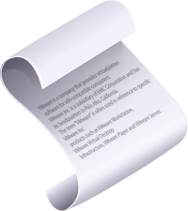

Virtual Volumes – The New De-facto Storage Paradigm
vSphere
Storage Policy-Based Mgmt.
Virtual Volumes
PE
PE
VASA Provider
Capabilities
Notes:
For vSphere environments, Vvols is the logical extension of virtualization into the storage world. Vvols, along with Virtual SAN, provides the foundation for software-defined storage in the SDDC.

Slide 42
vSphere 6.0 Fault Tolerance

Slide 43




vSphere 6.0 VMware Fault Tolerance
Additional new features
Benefits
Enhanced virtual disk format support
Ability to hot configure FT
Greatly increased FT host compatibility
Protect mission critical, high performance applications regardless of OS; No application-specific management and learning
Continuous availability – zero downtime and zero data loss for infrastructure failures; no loss of TCP connections
Fully automated response
Instantaneous Failover
Fast Checkpointing Sync
4 vCPU
4 vCPU
Secondary
Primary
Primary
ESXi
ESXi
Notes:
The benefits of Fault Tolerance are:
Protect mission critical, high performance applications regardless of OS
Continuous availability - Zero downtime, zero data loss for infrastructure failures
Fully automated response
Use cases
Any workload that has up to 4 vCPUs and 64GB Memory that is not latency sensitive (eg. VOIP, High-Frequency trading).
There is VM/Application overhead to using FT and that will depend on a number of factors like the application, number of vCPUs, number of FT protected VMs on a host, Host processor type, etc. We will release a performance paper around launch that will get into more specifics, for now the recommendation to customers is to test out using FT and see if it works for their workloads/use cases.
The new version of Fault Tolerance greatly expands the use cases for FT to approximately 90% of workloads.
The benefits of Fault Tolerance are:
Protect mission critical, high performance applications regardless of OS
Continuous availability - Zero downtime, zero data loss for infrastructure failures
Fully automated response
The new technology used by FT is called Fast Checkpointing and is basically a heavily modified version of an xvMotion that never ends and executes many more checkpoints (multiple/sec).
FT logging (traffic between hosts where primary and secondary are running) is very bandwidth intensive and will use a dedicated 10G nic on each host. This isn’t required, but highly recommended as at a minimum an FT protected VM will use more . If FT doesn’t get the bandwidth it needs the impact is that the protected VM will run slower.
Limits: either 8 vCPUs or 4 FT protected VMs per host – whichever limit is reached first
x2 VMs w/4 vCPU each (total 8 vCPUs)
x4 VMs w/2 vCPU each (total 8 vCPUs)
x4 VMs w/1 vCPU each (total 4 vCPUs)
Questions/Answers
------------
Will there be a performance impact? - Yes, compared to non SMP FT VMs, there will be some % of performance degradation. This overhead will be experienced by the VM, not the host. The amount depends on the workload and it’s characteristics. We will be posting some performance information and the recommendation is to test before using in production.
Any workloads that don’t work for FT? – Anything that is very latency sensitive (VOIP, High Frequency trading) is not a good use case. Otherwise try it out and see.
Any hardware requirements other than network bandwidth? - SMP FT will be optimized for the next generation of Intel CPUs (Intel Haswell). The only other requirements are the same for vMotion.
How are existing FT protected VMs handled when host is upgraded to vSphere 6? – They will continue to use the old version of FT. The old version of FT is deprecated in vSphere 6 and will be removed in the next version.
Is FT dependent on vCenter? – Only for initial configuration, when running FT uses vSphere HA for restarts/recreating a new secondary
Does FT require shared storage? – Yes, only for the FT configuration file and the tie breaker file
Copied from FT New features section:
Enhanced virtual disk support - Now supports any disk format (thin, thick or EZT)
Now supports hot configure of FT - No longer required to turn off VM to enable FT
Greatly increased FT host compatibility - If you can vMotion a VM between hosts you can use FT
Less requirements means that it is easier to use FT
Brought in from next slide:
Title: Fault Tolerance Now Supports Multiple vCPU VMs
- Up to 4 vCPUs and 64GB Memory per VM
- Maximum of either 8 vCPUs or 4 FT protected VMs per host

Slide 44

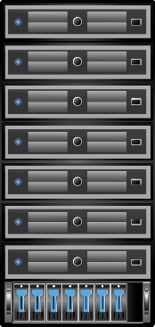

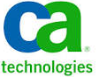

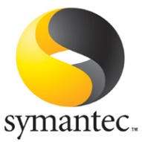



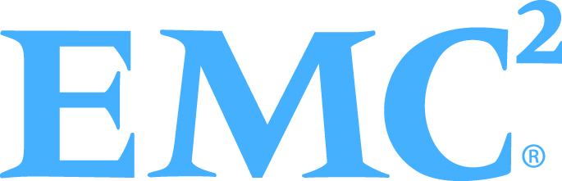

vSphere 6.0 - Backing up FT VMs
Support for vStorage APIs for Data Protection (VADP)
  API for non-disruptive snapshots
API
VADP
Backup Target
Many VADP solutions on the market
Notes:
FT VMs can now be backed up using standard backup software, the same as all other VMs (FT VMs could always be backed up using agents). They are backed up using snapshots through VADP.
Snapshots are not user-configurable – users can’t take snapshots. It is only supported as part of VADP.

Slide 45



vSphere 6.0 - Fault Tolerant Storage
Primary
Secondary
.vmx file
.vmx file
VMDK
VMDK
VMDK
VMDK
VMDK
VMDK
Datastore 1
Datastore 2
Each VM has it’s own:
vmx config file
vmdk files (new)
Allowed to be on different datastores (new)
Notes:
FT now creates a second copy of the VMDKs associated with a protected VM. This is an FT requirement.
This means that FT storage is now redundant (where with the previous version it used shared storage so it was not). It also means that storage requirements are doubled.

Slide 46
vSphere 6.0 - FT Capabilities by vSphere Version
Feature | FT (vSphere 5.5) | FT (vSphere 6.0)
vCPUs | 1 | 4
Virtual Disks | EZT | Any
Hot Configure FT | û | ü
H/W Virtualization | û | ü
Backup (Snapshot) | û | ü
Paravirtual Devices | û | ü
Storage Redundancy | û | ü
VSAN/VVols | û | û
Feature | FT (vSphere 5.5) | FT (vSphere 6.0)
HA | ü | ü
DRS | Partial | Partial
DPM | ü | ü
SRM | ü | ü
VDS | ü | ü
Storage DRS | û | û
VCD | û | û
vSphere Replication | û | û
Notes:
Compatibility of new FT with other VMware/vSphere features (most of this is the same as with the old version of FT)
vMotion (primary and secondary) – Yes
vDS – Yes
DPM – Yes
DRS – Partial (initial placement only)
HA - Yes
VSAN – No
vVOLs – No
vSphere Replication – No
Storage vMotion/SDRS – No
vCD – No
SRM – Yes (if using ABR and with some other caveats around file placement – also will have to re-enable FT at recovery site as VM will be recovered with FT unconfigured)

Slide 47
vSphere 6.0 vSphere Replication

Slide 48
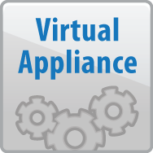




vSphere 6.0 – VMware vSphere Replication
End-to-end network compression
  Further reduces bandwidth requirements
Network traffic isolation
  Controls bandwidth, improves performance
  and security
Linux file system quiescing
  Increased reliability when recovering Linux VMs
Host Mgmt
vmknic0
LAN
VR Traffic
vmknic1
WAN
VMware Tools
Notes:
The features on this slide are new in vSphere Replication (VR) 2015
Compression can be enabled when configuring replication for a VM. It is disabled by default.
Updates are compressed at source (vSphere host) and stay compressed until written to storage. This does cost some CPU cycles on source host (compress) and target storage host (decompress).
Uses FastLZ compression libraries. Fast LZ provides nice balance of performance, compression, and limited overhead (CPU).
Typical compression ratio is 1.7 to 1
Best results when using vSphere 2015 at source and target along with vSphere Replication (VR) 2015 appliance(s). Other configurations supported - example: Source is vSphere 2015, target is vSphere 5.5. vSphere Replication Server (VRS) must decompress packets internally (costing VR appliance CPU cycles) before writing to storage.
With VR 2015, VR traffic can be isolated from other vSphere host traffic.
At source, a NIC can be specified for VR traffic. NIOC can be used to control replication bandwidth utilization.
At target, VR appliances can have multiple vmnics with separate IP addresses to separate incoming replication traffic, management traffic, and NFC traffic to target host(s).
At target, NIC can be specified for incoming NFC traffic that will be written to storage.
The user must, of course, set up the appropriate network configuration (vSwitches, VLANs, etc.) to separate traffic into isolated, controllable flows.
VMware Tools in vSphere 2015 includes a “freeze/thaw” mechanism for quiescing certain Linux distributions at the file system level for improved recovery reliability. See vSphere documentation for specifics on supported Linux distributions.

Slide 49

vSphere 6.0 – VMware vSphere Replication
Allocated?
Allocated?
Faster full sync
  Improves performance, reduces bandwidth consumption
Move replicas without full sync
  Balance storage utilization while avoiding RPO violation
Virtual appliances run SLES 11 SP3, supports IPv6
  Improved security and compatibility
Y
Compare
Y
N
N
Skip
Replica
Storage vMotion
Replica
Notes:
The features on this slide are new in vSphere Replication (VR) 2015
Compression can be enabled when configuring replication for a VM. It is disabled by default.
Updates are compressed at source (vSphere host) and stay compressed until written to storage. This does cost some CPU cycles on source host (compress) and target storage host (decompress).
Uses FastLZ compression libraries. Fast LZ provides nice balance of performance, compression, and limited overhead (CPU).
Typical compression ratio is 1.7 to 1
Best results when using vSphere 2015 at source and target along with vSphere Replication (VR) 2015 appliance(s). Other configurations supported - example: Source is vSphere 2015, target is vSphere 5.5. vSphere Replication Server (VRS) must decompress packets internally (costing VR appliance CPU cycles) before writing to storage.
With VR 2015, VR traffic can be isolated from other vSphere host traffic.
At source, a NIC can be specified for VR traffic. NIOC can be used to control replication bandwidth utilization.
At target, VR appliances can have multiple vmnics with separate IP addresses to separate incoming replication traffic, management traffic, and NFC traffic to target host(s).
At target, NIC can be specified for incoming NFC traffic that will be written to storage.
The user must, of course, set up the appropriate network configuration (vSwitches, VLANs, etc.) to separate traffic into isolated, controllable flows.
VMware Tools in vSphere 2015 includes a “freeze/thaw” mechanism for quiescing certain Linux distributions at the file system level for improved recovery reliability. See vSphere documentation for specifics on supported Linux distributions.

Slide 50
vSphere 6.0 vSphere Data Protection

Slide 51
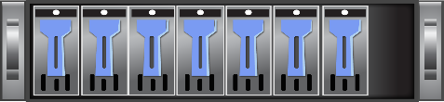

vSphere 6.0 VMware vSphere Data Protection
vSphere Data Protection includes all functionality previously included with vSphere Data Protection Advanced
Data protection and disaster recovery for VMs integrated with vSphere
Included with vSphere Essentials Plus and higher editions
Simple to deploy, easy to manage with the vSphere Web Client
Based on EMC Avamar and utilizes changed block tracking (CBT)
VDP
VDP
Backup Data Replication
Notes:
NEW: vSphere Data Protection Advanced functionality is now part of vSphere Data Protection (VDP). VDP Advanced edition is no longer available for purchase - customers get all of the features and benefits with VDP, which is included with vSphere 2015 Essentials Plus Kit and higher editions.
VDP enables both local data protection and offsite disaster recovery. Backups are performed locally - this backup data can then be replicated offsite for disaster recovery. The solution is well-integrated into vSphere and vCenter Server and utilizes the vSphere APIs for Data Protection (VADP). VADP includes changed block tracking (CBT). The first time a VM is backed up, it is a full (level 0) backup. Each subsequent (level 1) backup checks VADP for changed blocks and backs up only these changed blocks. Backing up only the changed blocks dramatically reduces back times, i.e., shorter backup window requirements, and reduces resource utilization.
Since VDP is based on EMC Avamar, VDP offers industry leading variable-length deduplication, which minimizes the amount of backup data capacity required for VDP. A VDP appliance can be deployed with thin provisioned disks to further minimize the backup data footprint.
VDP is managed using the vSphere Web Client - a UI that is familiar to the vSphere admin. Tasks such as creating backup jobs, restoring VMs, and setting up backup data replication are intuitive. It is literally possible to deploy VDP and create backup jobs in just a few hours.

Slide 52
vSphere 6.0 - vSphere Data Protection Use Cases
Data protection for small and medium sized organizations
  Backup of up to 800 VMs per vCenter Server environment
  Protect nearly any workload running in a VM
Remote office - branch office (ROBO), distributed environments
  Up to 20 VDP appliances per vCenter Server, external proxies
Data center migration and disaster recovery
  Backup VMs locally, replicate backup data to target location, restore VMs
Notes:
vSphere Data Protection (VDP) is designed to protect VMware virtual machine environments up to approximately 800 VMs, i.e., SMB organizations. For environments requiring protection of more than 800 VMs, customers and partners should consider other solutions that scale to these larger environments.
Nearly all workloads running in a VM can be protected with VDP. There are a few exceptions such as VMs with physical raw device mappings (RDM), VMs with very high levels of I/O (difficult to quiesce when creating snapshots and difficult to consolidate snapshots), and VMs that may require app-level quiescing not supported by VDP - example: Oracle database on Linux).
Organizations with smaller ROBO deployments are good candidates for VDP - ideally, less than 20 sites with a small number of VMs at each site. VDP currently supports up to 20 VDP appliances per vCenter. VDP external proxies can also be deployed to accommodate varying backup solution topologies and business requirements. External proxies can reduce the amount of backup data sent across a network and enable support for up to 24 concurrent backups (VDP appliance with no external proxies is limited to 8 concurrent backups).
Backup data stored locally can be securely replicated across WAN connections enabling planned migration of VMs or disaster recovery for VMs not requiring low recovery times (RTO) and/or recovery objectives (RPO). The benefits of using VDP for migration and recovery are lower storage requirements (backup data is deduplicated) and lower network bandwidth requirements (VDP replicates only unique data segments after deduplication has already taken place at the source and target).

Slide 53
vSphere 6.0 vSphere Data Protection
Features and Benefits
Up to 8TB of deduplicated backup data capacity per VDP appliance
  Protect approximately 150-200 VMs per appliance, minimal storage consumption
Agent-less VM backup and restore, file level restore
  Reduce complexity and cost
Application level backup and restore of SQL Server, Exchange, SharePoint
  Select individual databases, app-consistent quiescing, transaction log management
  Robust protection for mission-critical workloads
Notes:
Up to 8TB of deduplicated backup data capacity per VDP appliance. Each 8TB appliance can protect approximately 150-200 average sized VMs (50-60GB of data each) with a 3% change rate and a retention policy of 30 days. Results will of course vary in every environment based on VM sizes, the types of data contained in the VMs, data change rates, and retention policies.
No need to deploy agents to every VM. VDP utilizes the vSphere APIs for Data Protection (VADP) including changed block tracking (CBT) for backs and restores. This reduces the cost and complexity of deploying a data protection solution.
File level restore (FLR) is accomplished using nothing more than a Flash-enabled Web browser. A guest OS administrator or application owner (anyone with local administrative permissions in the VM’s guest OS) can use VDP’s FLR to restore files and folders without assistance from a backup or vSphere administrator.
VDP agents for SQL Server, Exchange, and SharePoint enable individual, application consistent database backup and recovery on virtual and physical machines. The agent for Exchange also provide granular level recovery (GLR) - restore of individual mailboxes. Using agents for these applications enable true app-consistent backup and recovery - for example, the SQL Server agent utilizes SQL Server’s virtual device interface (VDI). These agents also manage transaction logs (truncation, circular logs, etc.) and provide the option to enable multiple-stream backups. SQL Server cluster and Exchange Database Availability Group (DAG) configurations are supported.

Slide 54
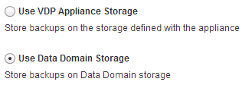
vSphere 6.0 vSphere Data Protection
Features and Benefits
Replicate backup data between VDP appliances and to EMC Avamar
  Easy, reliable, secure replication of backup data offsite for disaster recovery
EMC Data Domain support with DD Boost
  Protect more and increase reliability
Automated backup verification ensures backup data integrity, reduces risk
  Frequent “practice” restores provide the highest level of confidence
Notes:
Up to 8TB of deduplicated backup data capacity per VDP appliance. Each 8TB appliance can protect approximately 150-200 average sized VMs (50-60GB of data each) with a 3% change rate and a retention policy of 30 days. Results will of course vary in every environment based on VM sizes, the types of data contained in the VMs, data change rates, and retention policies.
No need to deploy agents to every VM. VDP utilizes the vSphere APIs for Data Protection (VADP) including changed block tracking (CBT) for backs and restores. This reduces the cost and complexity of deploying a data protection solution.
File level restore (FLR) is accomplished using nothing more than a Flash-enabled Web browser. A guest OS administrator or application owner (anyone with local administrative permissions in the VM’s guest OS) can use VDP’s FLR to restore files and folders without assistance from a backup or vSphere administrator.
VDP agents for SQL Server, Exchange, and SharePoint enable individual, application consistent database backup and recovery on virtual and physical machines. The agent for Exchange also provide granular level recovery (GLR) - restore of individual mailboxes. Using agents for these applications enable true app-consistent backup and recovery - for example, the SQL Server agent utilizes SQL Server’s virtual device interface (VDI). These agents also manage transaction logs (truncation, circular logs, etc.) and provide the option to enable multiple-stream backups. SQL Server cluster and Exchange Database Availability Group (DAG) configurations are supported.

Slide 55
MBU Latest and Greatest
vRealize Automation
  Standard Included with vCloud Suite Standard
  Advanced included with vCloud Suite Advanced
  Enterprise included with vCloud Suite Enterprise
  https://mylearn.vmware.com/register.cfm?course=216771&ui=www_field
vRealize Operations
  Standard included with vSOM and vCloud Suite Standard
  Advanced included with vCloud Suite Advanced
  Enterprise included with vCloud Suite Enterprise
  https://mylearn.vmware.com/register.cfm?course=236541&ui=www_field
vRealize Business Standard
  Included in vCloud Suite
  http://mylearn.vmware.com/register.cfm?course=236352

Slide 56
Thank You
VMware Cloud Infrastructure Technical Marketing
http://blogs.vmware.com/vsphere

