Slide 1

What’s New in
XenApp & XenDesktop 7.9
Current Release
May 2016
  <Name>
    <Title>

Slide 2

New Strategy

Slide 3


Apps & Desktops Service

Slide 4
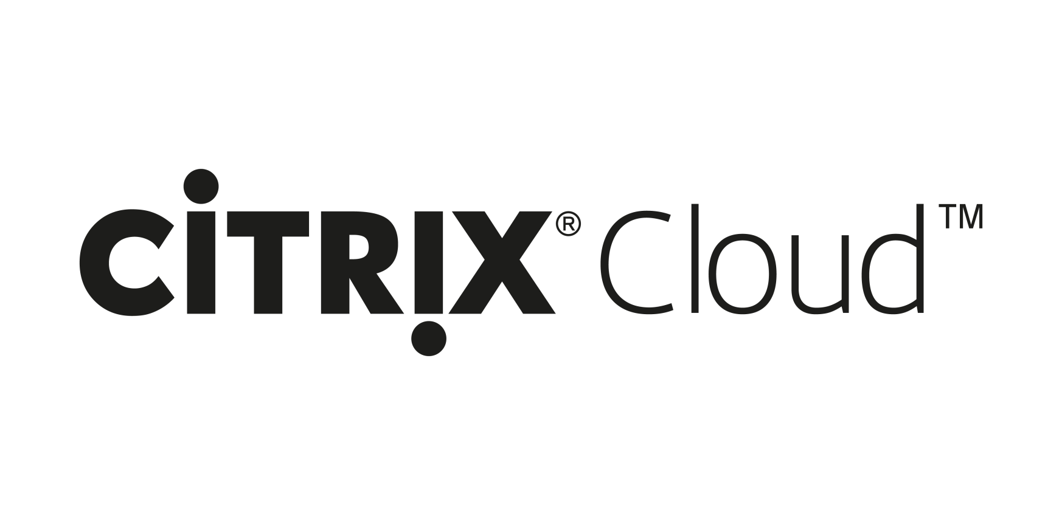
XenApp & XenDesktop Service

Slide 5
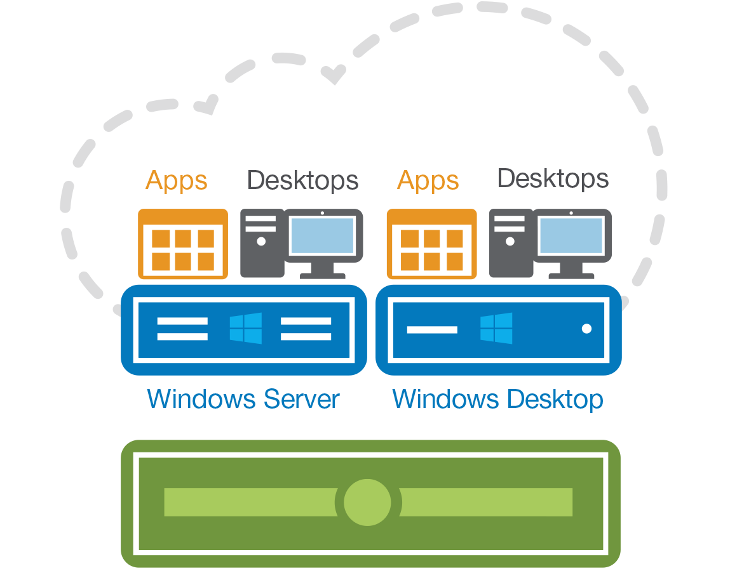
Director
EdgeSight
Studio
Notes:
Classic EdgeSight functionality, such as alerting, has been integrated to Director. The term “EdgeSight” has been deprecated.

Slide 6





&
Experience Continuity Across Devices Stunning Graphics Seamless Multimedia Optimized for Network Variations | Security Centralized Control FIPS Compliant Common Criteria Certified Secure Remote Access | Flexibility Apps & Desktops Any Hypervisor Any Cloud Integrated Solution

Slide 7

New Use Cases

Slide 8
&
7.9
Security

Slide 9

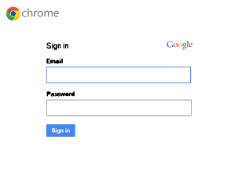
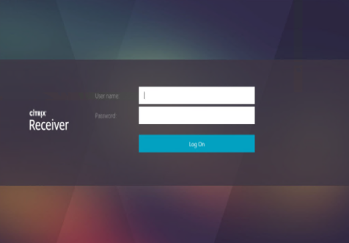
Authentication
Google User
Account
Active Directory
User Account
Notes:
Google Apps and Windows apps from a Chromebook. If my company is using Google apps, my users all have a Google account. If they have Win apps, they also have an AD account. Right now, my users login to Google to get Google apps with Gmail, then they login to AD to get Win Apps via XA/XD. Two separate accounts are needed.

Slide 10

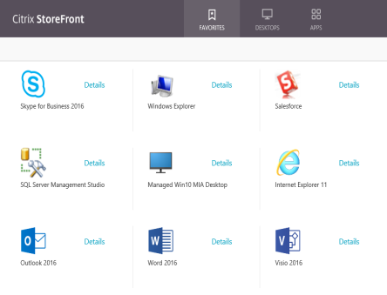
7.9 Authentication
Single Sign On Experience
“Password Free”
Google User
Account
Active Directory
User Account
Notes:
With 7.9 FAS, my user can login to Gmail, via FAS and their Gmail account is associated with an AD account and they get access to their Win and Google apps via one, non-Windows account (Better UX). If the Gmail account is compromised, the company can disconnect the link between Gmail and Windows AD and the compromised Gmail account doesn’t have access to business critical Windows apps. I think this is easiest to understand from ‘how it works’ as well as ‘security’. The other nice part about this angle is the ‘password free’ part, where the Gmail users only have to worry about their Google password and there is no additional password required to associate and authenticate to AD. Everyone needs an AD account or a mapping to an AD account to get their Win Apps, but the accounts can be generic/shared.

Slide 11

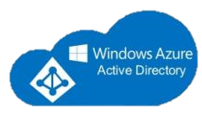




Identity Provider
okta
Google
SalesForce.com
empowerID
Microsoft Azure AD
Improvata
Identity
Providers

Slide 12
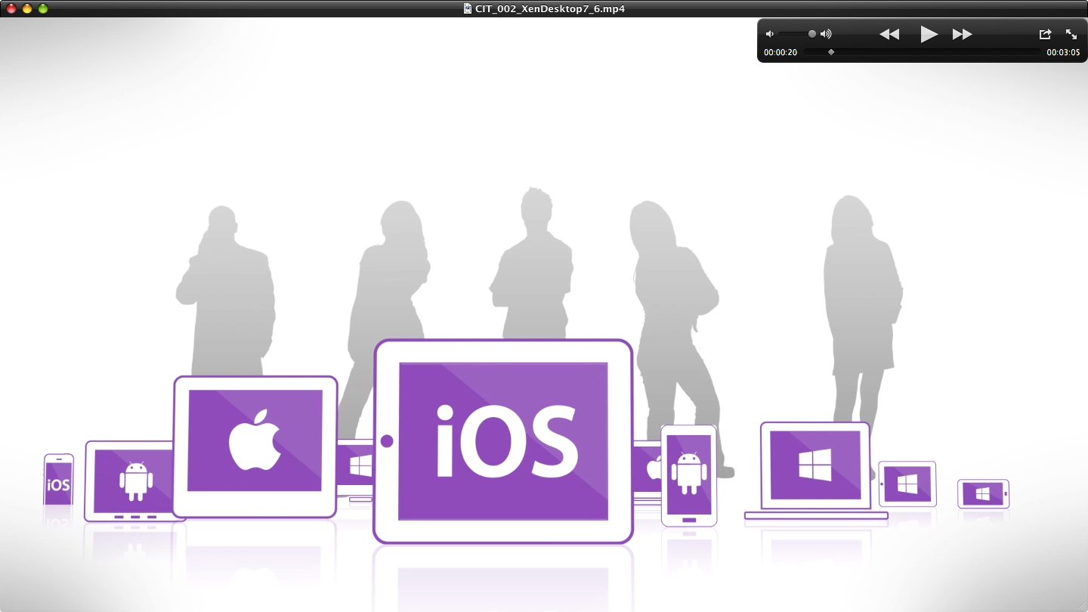




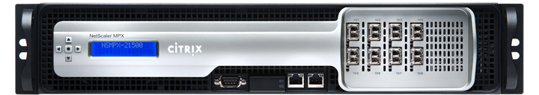

7.9 Federated Authentication Service
How it works
Identity Provider
SAML
Federated
Authentication
Service
Microsoft
Active Directory
(Cert Auth)
StoreFront
NetScaler
Notes:
Federated Authentication Service is not functional in XA/XD Service

Slide 13

7.9 Federated Authentication Service
Additional Use Cases
Mergers & Acquisitions
Partners & Contractors
Multi-Tenant Management
M&A

Slide 14

&
7.9
Experience

Slide 15

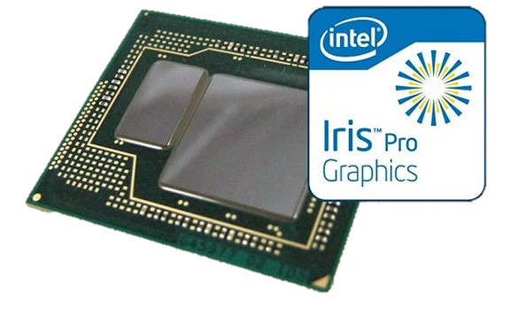
Enhanced Graphics Performance for Every User
All-in-one CPU & GPU delivers high resolution visuals at an affordable price
Best for mainstream graphics applications
  Targeted for Desktop operating systems
  Browser acceleration, imaging, etc.
HDX 3D Pro integration with Intel Iris Pro Graphics
  CPUs with built-in graphics processing
Supported on XenServer 7.0 and bare metal
Only XenApp & XenDesktop with XenServer supports:
  Intel Iris Pro Direct pass-through
  Intel Iris Pro Virtual GPU sharing
Notes:
- NVIDIA GRID still best platform for high-end graphic requirements in virtualized environment (XenServer, VMware ESX)
- Iris Pro graphics is currently supported for server VDA 7.X (XenApp 7.X on Windows server 2012 R2)
Intel E3 Xeon Platform available from numerous industry vendors HP, Cisco, Supermicro
HDX 3D Pro is available in all product editions as of XA/XD 7.8

Slide 16
&
7.9
Flexibility

Slide 17


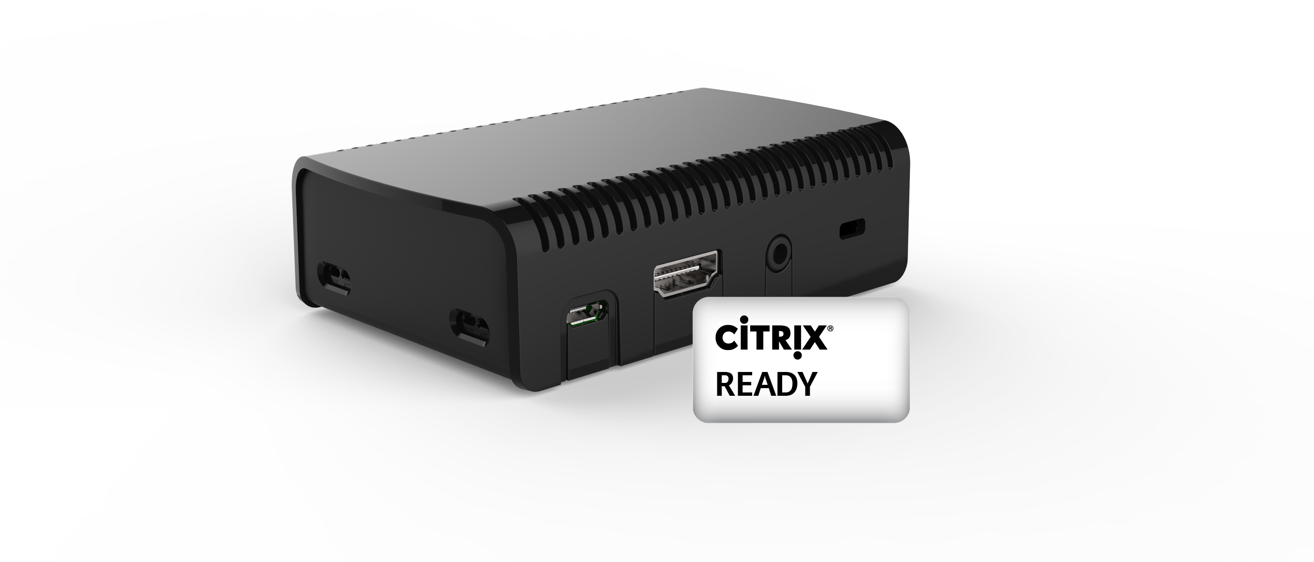
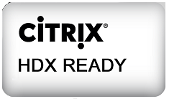
Introducing Citrix HDX Ready Pi
High performance, Citrix verified thin client for under $99
Partnering to bring Raspberry Pi to the enterprise
  Joint partnership with Raspberry Pi and Citrix
  OEM by ViewSonic and Micro Center
  Based on new Raspberry Pi 3
High performance, low-cost HDX client
  Additional volume discounting may apply
Fully assembled thin client, in single package
  Systems preassembled and packaged
  Systems preconfigured and licensed
  Embedded Flash Memory card
  Preloaded with Citrix Receiver and device management software
Notes:
Keyboard, mouse and additional peripheral devices are separate
Great option to replace legacy and/or defective hardware where peripherals already exist

Slide 18

Central Image Management for Any Hypervisor
XenApp & XenDesktop 7.9 enable Machine Creation Services (MCS) for Nutanix Acropolis hypervisor
XenApp / XenDesktop
Provisioning Acropolis VDI instances from Citrix Studio
  Integrated Management
  Strength of Citrix & Nutanix partnership
Low-cost, high-performance VDI
  Predictable pay-as-you-grow scaling
  Turn-key deployments
  Fast, fully-redundant local storage
Acropolis
vSphere
Hyper-V
XenServer*
*NOT supported
on Nutanix
Notes:
Nutanix
We are also very excited to announce our deep partnership with Citrix. XenApp and XenDesktop are now certified on Acropolis Hypervisor. So moving forward, for your VDI deployments – all you need is Nutanix and Citrix. This is for both the Citrix infrastructure servers as well as the desktops. This not only helps you bring down your licensing costs/TCO down significantly, but also simplifies support.
XenApp and XenDesktop Service
-MCS Provisioning to Acropolis is not currently supported in the XenApp and XenDesktop service. The

Slide 19
Machine Creation Services I/O optimizations
Reduce IOPS by up to 95% driving down shared storage costs
Machine Creation Services (MCS)
  Available in every edition of XenApp and XenDesktop 7.x
Leverage low-cost, high-performance RAM as alternative to expensive shared storage
  RAM cache with overflow to disk for MCS
Available on all supported hypervisors
  Citrix XenServer
  Microsoft Hyper-V
  Nutanix Acropolis
  VMware vSphere
Applies to pooled and dedicated machines
*Based on Citrix Internal Test Data

Slide 20
New Technology

Slide 21
What’s new in Provisioning Services 7.9
Enhanced capabilities for non-network booting
Leverage the latest, secure boot standard for target devices
  UEFI BDM Support integration with XenDesktop Setup Wizard
  A secure way to boot target devices without special network configuration
Easily update boot disk settings for target devices
  BDM Update Support
  Especially useful in large environments
  No need to destroy and recreate target devices

Slide 22
New advanced capabilities for HDX printing
Enhancements to the Citrix XPS Universal Print Driver
(Helps prevent the need to manage vendor print drivers)
  Paper tray selection
  Stapling
Universal Print Server load balancing
(Ideal for large environments)
  Load balancing
  Fault tolerance
Virtual Apps + Desktops
Print Servers

Slide 23
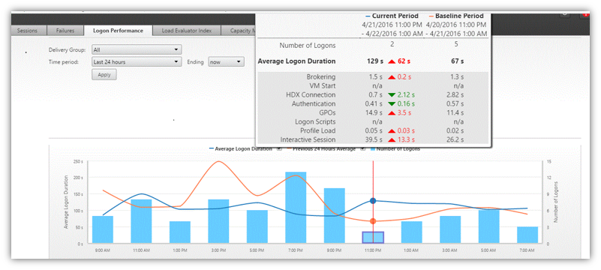
Director monitoring improvements
Enhanced logon duration metrics

Slide 24




Citrix Receiver
Receiver for iOS 7.0
Session Reliability
IPv6 Support
HDX SDK
Receiver for HTML5 2.0
Multi-touch and Mobility pack
Improved in-session toolbar
Client-side app switcher
Receiver for Chrome 2.0
Seamless windows
Connection Center
Redesigned toolbar
Receiver for Android 3.9
Unified user experience (Web UI)
Enhanced multi-monitor support
Improved keyboard handling
Notes:
All of these Receivers have been released except for the iOS one.
Please reach out to Dan McCurley to get early access to the iOS 7.0 release.

Slide 25
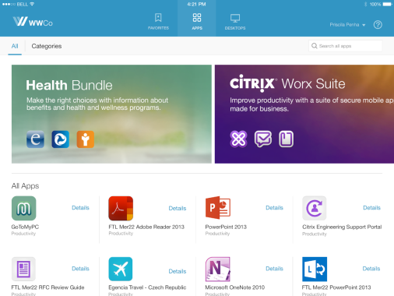
What’s new in StoreFront 3.6
Allow StoreFront to be non-default IIS website
Deploy on Non-System Drive
Remove domain requirement
Load balancing for non-identical Farms/Sites
Storefront Client Detection UI Enhancements for Unified Gateway
Storefront Admin Console Performance Optimization

Slide 26

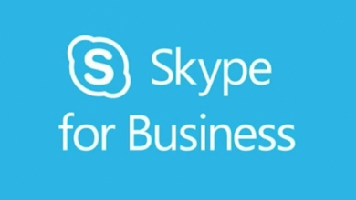
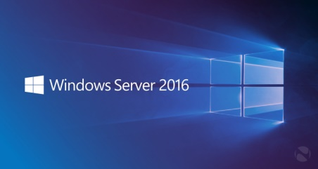
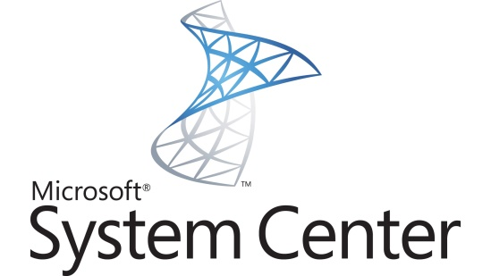
Microsoft Integration
HDX RealTime Optimization Pack 2.1
(available in June)
Location Services from endpoint
QoE Reporting
SfB 2016 Ready
Windows 10
HDX 3D Pro
Remote PC Access: Secure Boot
Windows Server 2016
Try Tech Preview 5
Share TP Feedback
System Center
Updated SCOM Packs
Updated Citrix Connector for SCCM

Slide 27
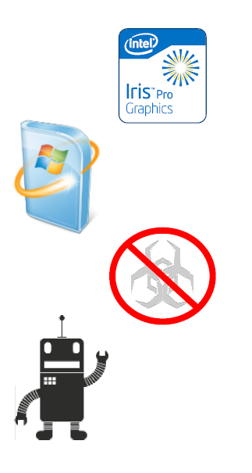
XenServer 7.0 Enhancements for XenApp and XenDesktop
Citrix unique solution features increase operational efficiency and lower TCO
XenServer’s virtualized graphics leadership continues with
Intel (GVT-g) Iris Pro Graphics
Automated Windows VM driver installs & updates via
Microsoft Update Services
Unique Secure Scan APIs for “better than physical”
agentless workload protection
Simplified Infrastructure Management with proactive
monitoring & reporting in Health Check

Slide 28
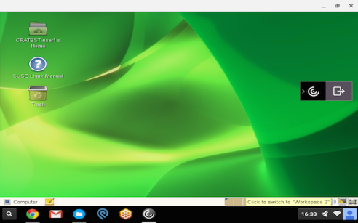
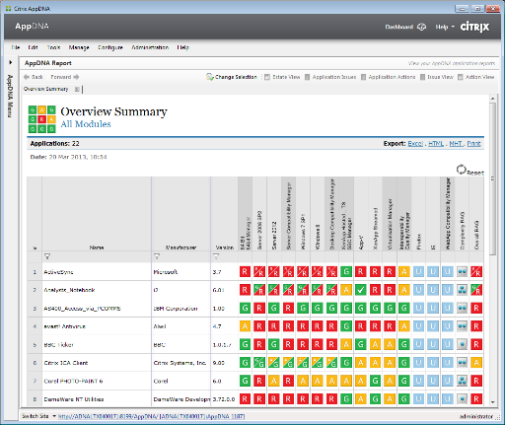


Additional releases
AppDNA 7.9
Enhanced AppDisk integration
Expanded reporting for security
Linux VDA 1.3
Client drive mapping
CentOS support
Call Home V2
Diagnostic uploads
Additional datapoints
Notes:
CentOS is free which should open new markets and is ideal for demos, PoCs, etc.
Sales guidance that 7.9 is much more than a maintenance release.

Slide 29
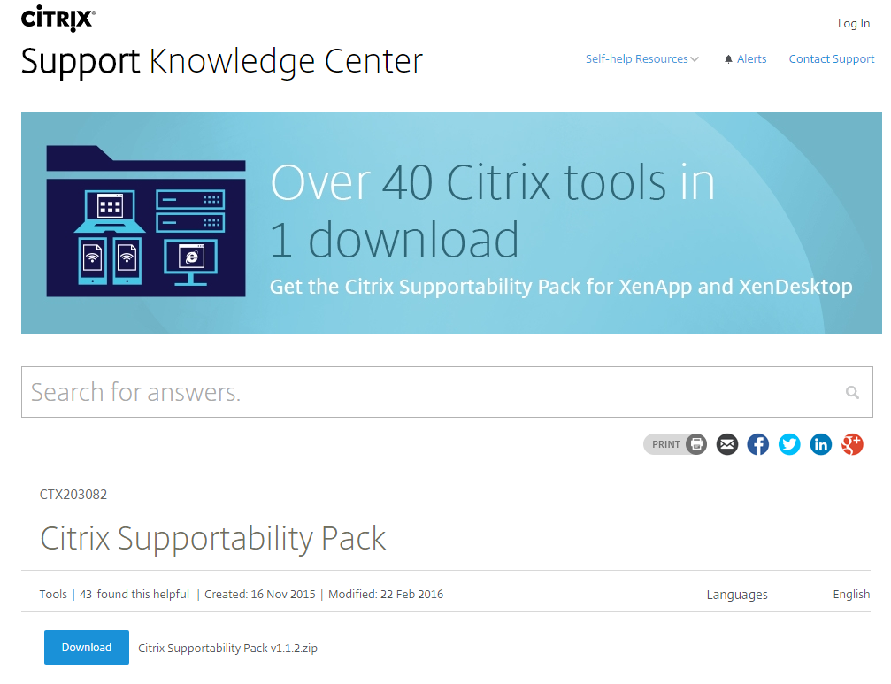
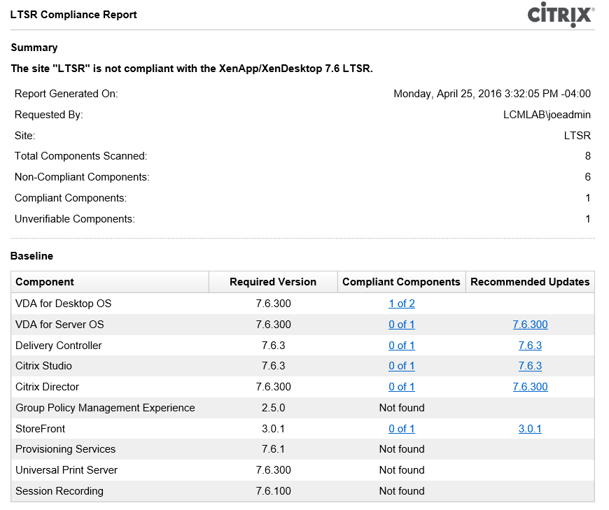
Supportability
Supportability Pack
Now with 50+ tools
http://support.citrix.com/article/CTX203082
LTSR Compliance Tool
Tech Preview
Verify proper component versions
http://support.citrix.com/article/CTX209577
Notes:
https://www.citrix.com/blogs/2016/02/17/now-playing-xenapp-xendesktop-in-the-citrix-supportability-pack/
The Supportability Pack is a collection of support utilities developed by Citrix engineers to help diagnose and troubleshoot XenDesktop and XenApp on the Microsoft Windows platform. The tools are quite diverse: some automate and speed up data-log analysis; others simulate common conditions to keep you ahead of the curve. Still others complement the official tools, going into further diagnostics or health-check reports. Some tools are new, others may have been shared earlier, but now they are all catalogued by feature and component making it easier to find the right one and keep track of any updates.
The goal in creating this pack was to turbo-charge the Citrix administrator’s ability to support Citrix environments. By making these tools available to our customers and partners, we hope they will help others during testing and troubleshooting of these products. The first release consists of 47 diagnostics tools (from the hundreds of tools in our library) that were selected based on usefulness and popularity. Another release is planned later this year, with even more great utilities in store.

Slide 30


Download Today
Prelaunch, linger, anon logon
Next Gen Thinwire
HDX Framehawk GA
7.9
Faster SmartCard logon
FIPS & Common Criteria
Clipboard policies
X1 Mouse
Federated Authentication
MCS I/O Optimizations
Intel Iris Pro Graphics
Nutanix MCS provisioning
Enhanced Director reporting
Advanced printing capabilities
Secure Browser
Long Term Service Release
StoreFront 3.5
AppDisk
AppDNA for App Disk
App-V Integration
Enhanced App Publishing
Session Recording for VDI
Framehawk & HDX 3D Pro
Session recording
Watermarking (Labs)
Jailbreak detection
Linux GA and 2.0
Windows 10 support Day 1
Supportability tools
Automated migration service
DesktopPlayer (Mac/Win)
Acquire Framehawk
Multi-geo management
Horizon migration service
Skype for Mac/Win/Linux
Advanced alerting
1st GPU support
Workspace Cloud GA
Mobile SDK
Hybrid cloud
provisioning
Unified app/desktop
cloud-enabled platform (FMA)
Browser Apps Service (Labs)
Announce
cloud support
PVS write cache
AppDNA Express (Labs)
2012
2013
2014
2015
2016

Slide 32


