Slide 1

What’s New – Technical
November 2016
XenApp & XenDesktop 7.13
Daniel Feller
    Lead Architect
    (Twitter: @djfeller)

Slide 2
XenApp and XenDesktop 7.13
What’s New
  Provisioning Services Accelerator
  Hypervisor Introspection
  Smart Check
What’s Improved
  HDX
  SmartAccess for mobile
  StoreFront SAML Authentication
  XenServer Patching
What’s Worth Noting
  Provisioning Services for Linux
  HDX 3D Pro for AMD
  H.264 encoding with Intel Iris Pro
  Expanded USB Device Support
  Linux Seamless Published Apps
  Gateway/Storefront setup
  VDA Registration optimizations
  New Director filters
  Generic client IME
  64bit AppDNA
Notes:
As you can see, the 7.13 release of XenApp and XenDesktop includes many new features and improvements. These items will be discussed in more detail. In addition, there are many other items worth noting, including:
Provisioning Services supports Linux target devices running RHEL, SLES and Centos on XenServer and vSphere. This first release does not support UEFI but it does support server-side and RAM Cache with disk overflow.
HDX 3D Pro now supports AMD Multiuser GPU using the AMD FirePro S-Series server cards, which adds more options for users requiring advanced graphics performance.
In addition to AMD, Intel Iris Pro graphics chips now supports using the hardware to encode H.264 streams, helping to reduce CPU utilization.
XenApp continues to improve support for USB devices like WACOM pen tablets, allowing it to function as a pen input device with pen sensitivity also working.
Linux VDAs now support publishing applications as seamless applications, which appear on the endpoint device as any other native app even though it runs remotely on the Linux VDA.
Setting up Gateway and StoreFront has been simplified in that gateway settings can be imported into StoreFront and all relevant information is automatically added (callback URLs, STAs, remote access settings).
The entire VDA registration process has been optimization to take less time to complex, especially during a registration storm. This should help reduce the impact the VDA registration storm has on Local Host Cache.
Director includes a new filter for idle time, helping admins to find those sessions that are currently inactive.
Sessions will now use the IME (Input Method Editor) settings from the client and not from the server, which improves the user experience for Asian languages
By moving AppDNA to 64bit, the time it takes to import and analyze is significantly faster.

Slide 3
Simple and Scalable Management
Smart Check

Slide 4
Smart Check
Why
Admins unaware of problems in Citrix environments until after end-users are disrupted
Long time to debug
Unclear on how to fix
Notes:
Smart Check was developed to overcome an admin experience issue where users would be the ones identifying issues within an environment instead of the admins. The goal of smart Check is to be Proactively diagnosis and repair of issues in your Citrix environments

Slide 5
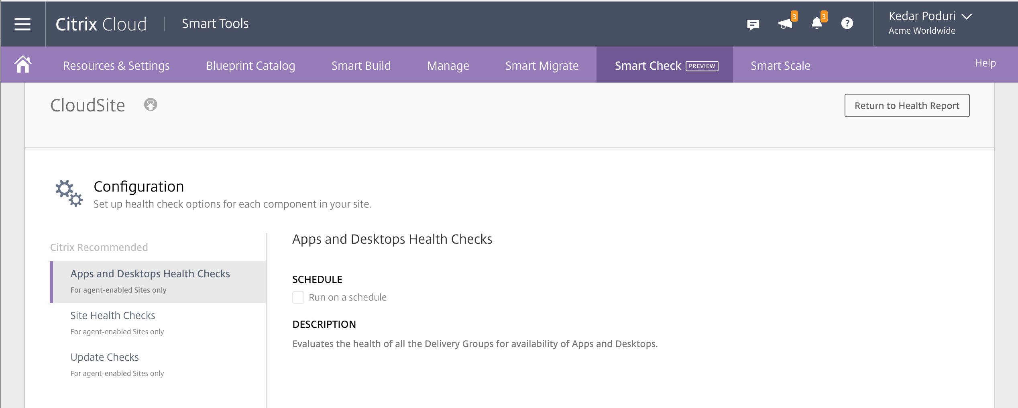
Smart Check
Overview
Check VDA capacity / health
Check site health
Identify missing updates
Notes:
Smart Check includes multiple areas of analysis:
VDA Capacity and health: verify the availability of all the Delivery Groups in your Site to ensure they are capable of delivering applications and desktops to your users.
Site health: which provide a comprehensive evaluation of all the FMA services in your Site. In addition to checking the availability of these services, these checks also look for other health indicators such as database connectivity.
Update identification: Update Checks evaluate the patch level of the Delivery Controllers and VDAs in your Site, recommend applicable hotfixes, and provide links to other Citrix resources so you can learn more about the update.

Slide 6
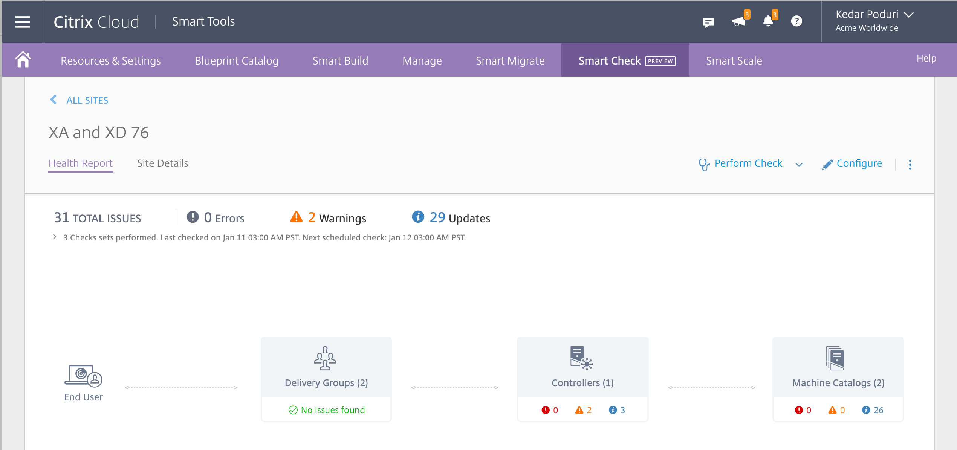
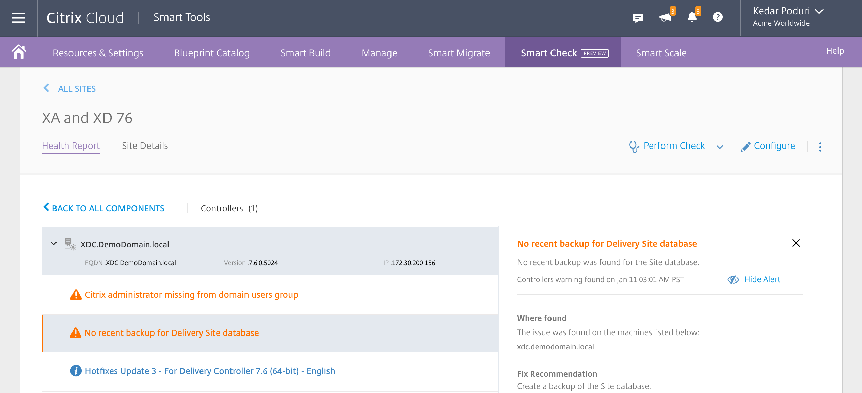
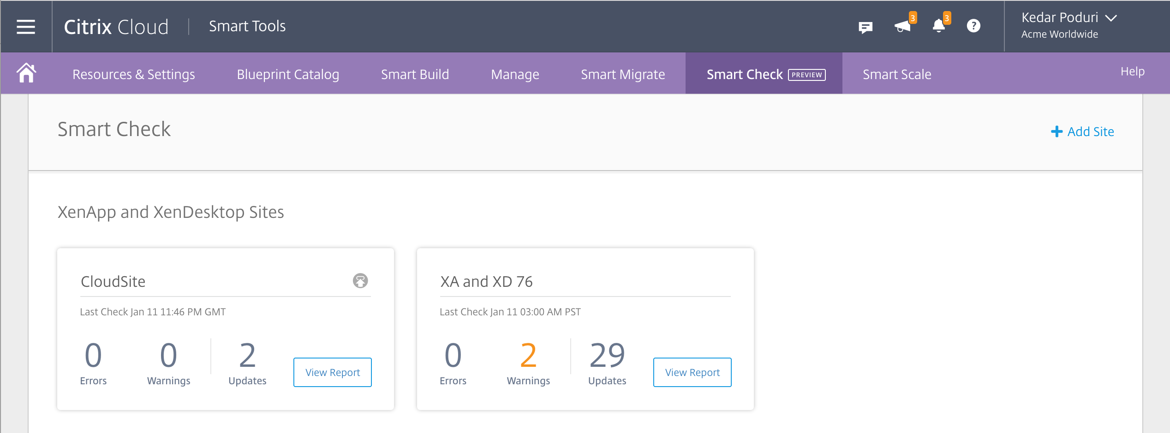
Smart Check
Overview
Dashboard per site
Site summary
Detailed analysis
Notes:
Smart Check is grouped based on XA/XD site. If you have multiple sites, each one is added and the summary screen provides a cross-site overview.
[Click] Looking into a single site, we can see the health of the main components from the controllers to the VDAs.
[Click] By looking a little deeper into one of the components, we then get a detailed report about potential issues and how to correct.

Slide 7
Smart Check
Current checks as of February 7, 2017
CDF tracing is enabled.
Database updates (XDUs) have been applied.
Database version matches the expected version.
Feature names are valid.
Windows Firewall rules are enabled.
Host connection is not in maintenance mode.
HTTP/HTTPS namespace reservation exists.
Read Committed Snapshot is enabled.
Service registration is in completed state.
SQL Server version and service-pack level checked.
Stored Configuration service instances are valid and up-to-date.
Citrix administrators have rights assigned.
Citrix administrators are included in Domain Users group.
The license server information matches the information in the Configuration Service.
The selected account for machine creation is valid.
Citrix Monitor service can access the Monitoring database.
Citrix Monitor service data processing has started and is running smoothly.
Citrix Monitor service data querying module has started.
Citrix Monitor service is using the correct settings for analyzing and removing unnecessary data.
Citrix Monitor service is using the correct settings for grooming the data.
Citrix Monitor service is using the correct settings for the consolidating data.
Monitoring data collection has started.
Database schema matches the expected schema.
A hypervisor connection can be established.
Hypervisor infrastructure has been verified.
Hypervisor networks have been verified.
Hypervisor storage locations have been verified.
An Organization Unit in the AD identity pool exists.
The AD identity pool, as configured, is suitable for provisioning accounts.
The AD identity pool is unlocked.
A recent database backup exists.
The licensed product edition supports Configuration Logging.
The Configuration Logging database is connected.
Configuration Logging machine SID resolution is successful.
The virtual machine has disks attached.
Connectivity to core XenDesktop services is established.
Connectivity to peer database instances is established.
File-based logging permissions are enabled and sufficient disk space is available.
A XenDesktop service account exists.
A XenDesktop service account is available in the AD Identity Service.
The Site database can be reached.
The next account generated by the AD identity pool does not exist already.
The service instance is registered with the Configuration Service.
Delivery group check
Delivery controller patch level
VDA patch level
Notes:
So what is being chcked? Quite a lot. This is the current list as of February 7, 2017. And because this is a cloud service, the list can be easily expanded.

Slide 8
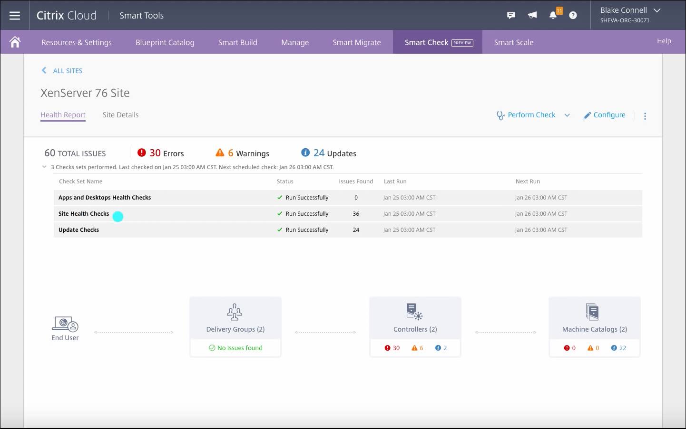
Smart Check
Demo
Demo Video: https://www.youtube.com/watch?v=RUTL1X_nBSg

Slide 9
Smart Check
Design Considerations
Delivered as a Citrix Cloud offering (https://Smart.cloud.com)
Additional checks continuously added
Available for anyone with active Customer Success Services: Select

Slide 10
Simple and Scalable Management
Provisioning Services Accelerator

Slide 11
Provisioning Services Accelerator
Why
OS Disk
Server
Shared Storage
Provisioning Services Server
Hypervisor (XenServer)
Notes:
Provisioning Services is a network-based image delivery system. In order to boot a virtual machine, the PVS server must read blocks of data from the OS disk and then stream those blocks to the hypervisor for the VM to load. Imagine the hypervisor host is booting 100 Windows 10 virtual machines at 8:00AM.
[Click] This process puts strain on the OS Disk as well as on the network link between the Provisioning Services server and the hypervisor.

Slide 12
Provisioning Services Accelerator
Why
Read Cache (RAM)
OS Disk
Server
Shared Storage
Provisioning Services Server
Hypervisor (XenServer)
Notes:
If sized properly, the Windows Server, hosting Provisioning Services, is able to mitigate the storage Read IO to the OS disk by using system cache memory to store recently read blocks of the OS disk.
Typically, the recommendation is to increase the RAM Allocation for the Provisioning Services server by 2GB for each unique image. But the blocks of data must still traverse the network for each virtual machine.

Slide 13
Notes:
As you can easily see, as you add more target VMs, the amount of network utilization increases linearly.

Slide 14
Provisioning Services Accelerator
Overview
Dom0
Read Cache (RAM)
OS Disk
PVS Accelerator
Server
Shared Storage
Provisioning Services Server
Hypervisor (XenServer)
Notes:
XenServer PVS Accelerator provides local disk and RAM based caching for read IO, originally utilized by Machine Creation Services. Provisioning Services can also utilize XenServer PVS Accelerator, which caches portions of the PVS image to the local XenServer Hypervisor.

Slide 15
Provisioning Services Accelerator
Overview
Read Cache (RAM)
OS Disk
vSwitch
Server
PVS Accelerator
Shared Storage
Provisioning Services Server
Hypervisor (XenServer)
Notes:
[Click] Let’s look at how the PVS Accelerator functions for a newly booted XenServer Host.
[Click] A VM will boot and try to contact the PVS server. Because PVS is network based, the virtual switch in Dom0 has a packet filter configured specifically for Provisioning Services. The virtual switch routes read requests through PVS Accelerator . As the request can’t be fulfilled locally (because the cache is empty from the XenServer boot), the PVS request is injected back into the virtual switch and routed to the PVS host.
[Click] As data gets sent to the booting VM, the data is also cached locally with PVS Accelerator .
It takes between 200-500MB of data to boot a VM, all depending on the operating system. Without PVS Accelerator , each VM will request the same data. If a XenServer can host 100 VMs, that equals 20,000-50,000GB of data crossing the network during early morning bootup. With PVS Accelerator , that number drops by 99% to 200-500MB. And, because of the it takes to traverse the network, have the PVS server request the data blocks and retransmit across the network for the VM to read, the time it takes to bootup is drastically reduced as well.

Slide 16
Provisioning Services Accelerator
Overview
Read Cache (RAM)
OS Disk
vSwitch
Server
PVS Accelerator
Shared Storage
Provisioning Services Server
Hypervisor (XenServer)
Notes:
A second VM boots. The VM requests data from the PVS server. Just like before, XenServer routes the request through PVS Accelerator . But this time, the request stays local as the data is available, saving network bandwidth and increasing boot-up speed.

Slide 17
Notes:
Now, instead of having network requirements increase linearly based on the number of target VMs, it remains flat, after the first VM boots as the data is delivered from the local PVS Accelerator cache.

Slide 18
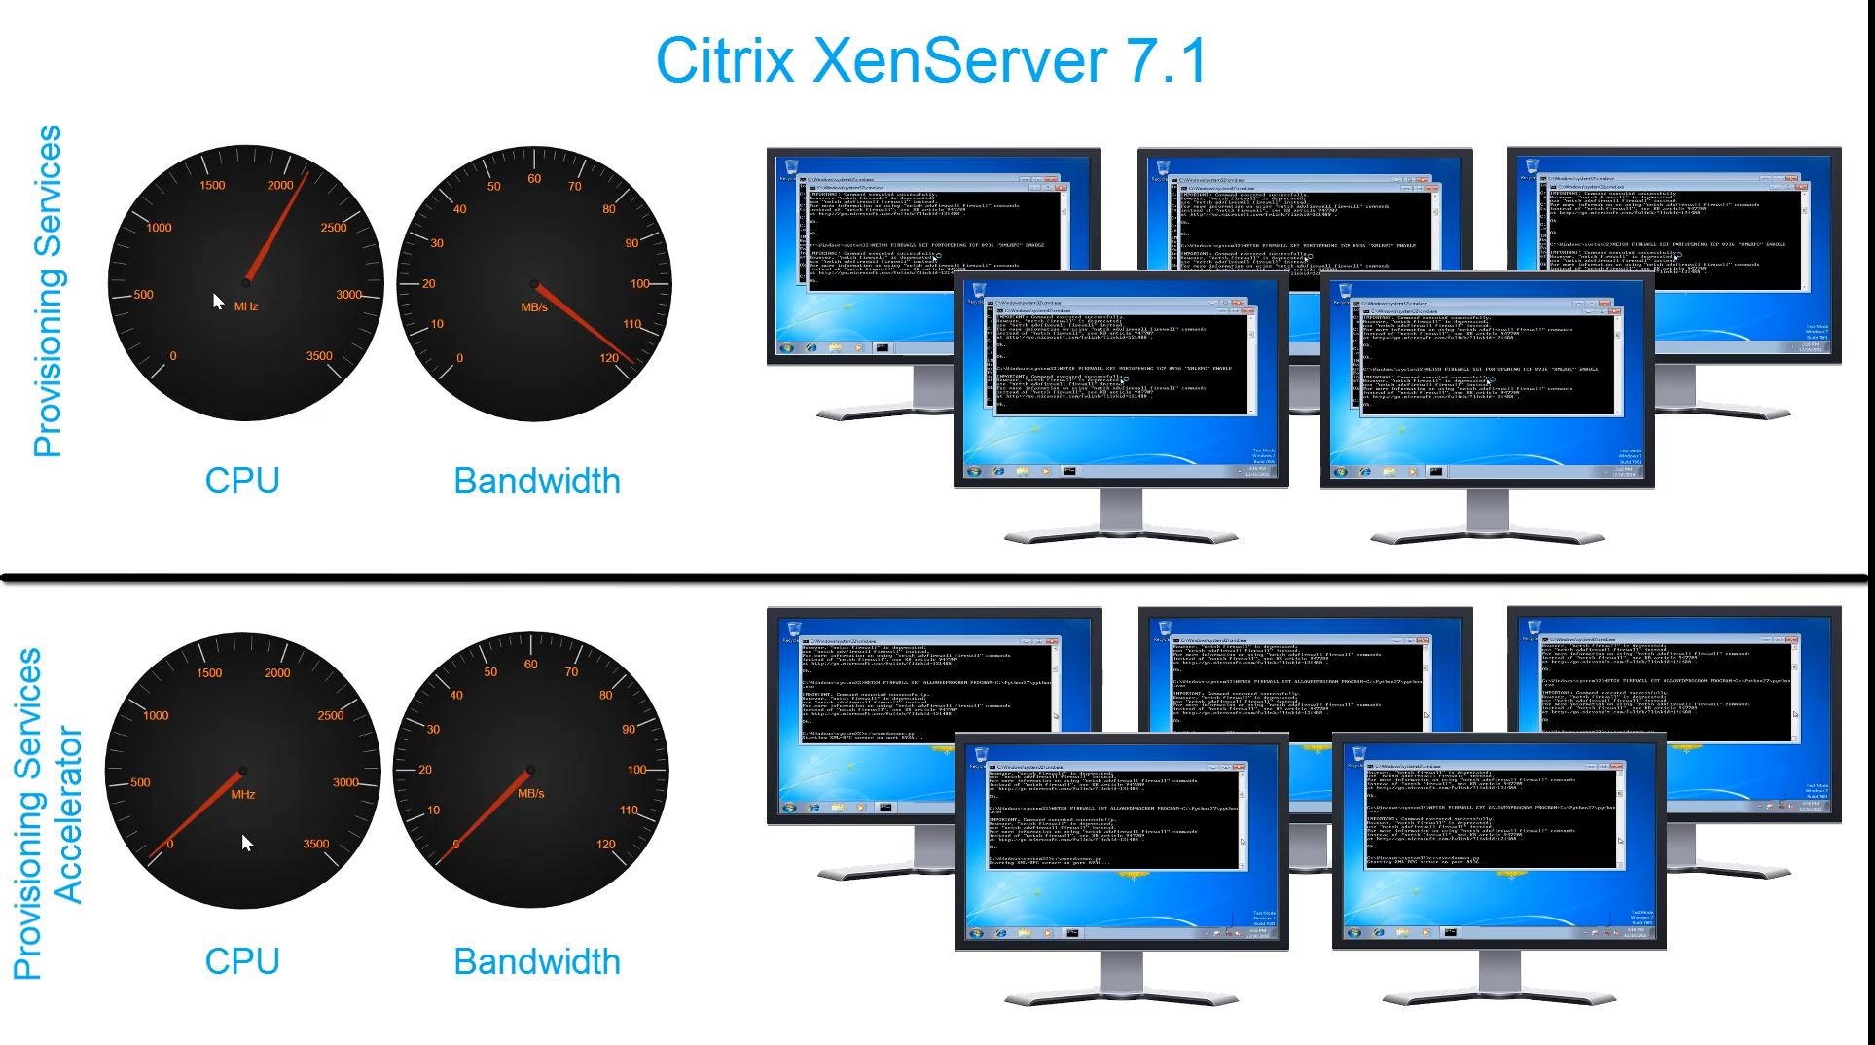
Provisioning Services Accelerator
Demo: Network and CPU Utilization
Demo Video: https://www.youtube.com/watch?v=l_vhMf3SFks
Notes:
And In the third example, we show how how long it takes to copy files across a WAN connection with 250ms latency and 1% packet loss. This example truly demonstrates the impact Adaptive Transport has on the user experience.

Slide 19
Provisioning Services Accelerator
Results
Notes:
If we look at a test with 50VMs, we saw some interesting results.
[Click] PVS server CPU utilization went from 70 to 5%
[Click] PVS Network Throughput went from 60Mbps to 5
[Click] and VM boot time went from 112 seconds to 83
Adding PVS Accelerator improves performance

Slide 20
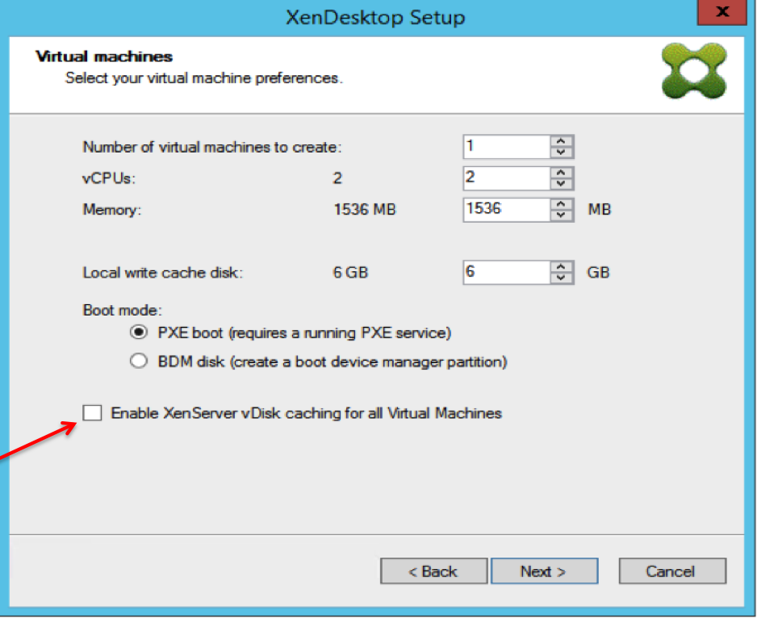
Provisioning Services Accelerator
Configuration
XenServer
  XenServer 7.0 requires addon install
  XenServer 7.1 integrated
  Define new Provisioning Services site
Provisioning Services
  New XenServer vDisk Caching option
  Only visible for XenServer connections
  First time setup requires selection of XenServer Site

Slide 21
Provisioning Services Accelerator
Design Considerations
XenServer ONLY
License Requirements
  XenApp/XenDesktop (All Editions)
  XenServer Enterprise
Consumes additional XenServer Dom0 resources
Configure on every XenServer host receiving vDisk image streams
Select to use RAM, disk or combination

Slide 22
Contextual and Embedded Security
Hypervisor Introspection (HVI)

Slide 23
XenServer Hypervisor Introspection (HVI)
Why
Ring 3: Unprivileged
Applications
Ring 0: Privileged
Kernel / Device Drivers
Notes:
In an x86 CPU architecture, there are multiple rings of protection.
[Click] User applications, like Word, Outlook, Acrobat, etc., execute in ring 3.
[Click] When we move down to ring 0, we find the privileged access components like kernel and device drivers. In case you are wondering where rings 1 and 2 are, they are only used for special use case.
The ring-based design protects data and functionality from faults and malicious behavior. If Microsoft Word has an issue and crashes, Word won’t bring down the entire operating system as it only functions at ring 3 while the core OS runs in ring 0.
The goal of an attacker is to achieve access to ring 0, from there, they can get root access and escalate privileges by exploited vulnerabilities and misconfigurations.

Slide 24
XenServer Hypervisor Introspection (HVI)
Why
Ring 3: Unprivileged
Applications
Ring 0: Privileged
Kernel / Device Drivers
Notes:
In order to protect the environment, organizations may rely on virus and malware scanners. In order for these to be effective, they need to sit in ring-0, the privileged ring.
However, scanners work like vaccinations. They only work on known viruses/malware. The scanner must have the viruses/malware fingerprint and methods for eradicating and cleaning.
Also, once the viruses/malware is on the system, it might try to install a rootkit, which hides from the OS and scanner that the system has become infected.

Slide 25
XenServer Hypervisor Introspection (HVI)
Overview
Ring 3: Unprivileged
Applications
Ring 0: Privileged
Kernel / Device Drivers
Ring -1
Hypervisor
Notes:
We need to move down another layer, to ring minus 1, which is the hypervisor ring. Hypervisor Introspection operates at a level of privilege that is underneath the tools installed in-guest. While a
rootkit running in a virtual machine may run with kernel-level (ring-0) privilege, as does in-guest security software, HVI performs at the hypervisor level of privilege. It is completely separate

Slide 26
XenServer Hypervisor Introspection (HVI)
Overview
Virtual Machine
Virtual Machine
Virtual Machine
Virtual Machine
Control Domain (dom0)
Security Appliance (domU)
Direct Inspect APIs
XenServer Hypervisor
Notes:
Bitdefender HVI leverages the XenServer Direct Inspect APIs. The Introspection Engine applies security rules to virtual machine memory while remaining isolated from the protected virtual machines.
Whether the protected endpoint is Windows or Linux, server or desktop, HVI provides insight at a level that is impossible to achieve within guests. Effectively, it is inspection from below the guest operating systems; ring-minus-one insight and control.
Just as the hypervisor controls hardware access on behalf of each guest virtual machine, HVI has intimate knowledge of both user-mode and kernel-mode in-guest memory. The result is HVI has complete insight into guest memory, and therefore full context. At the same time, HVI is isolated from the protected guests, just as the hypervisor itself is isolated.

Slide 27
XenServer Hypervisor Introspection (HVI)
Overview
App
Unprivileged
Operating System
Privileged
Kernel & device drivers
Security Appliance (domU)
Memory
Direct Inspect APIs
XenServer Hypervisor
Notes:
Using hypervisor introspection, a supported security solution is able to watch guest memory in real time, detecting malware as it executes inside the VM.
By virtue of the isolation the hypervisor provides, the security solution can no longer be attacked by the malware.
In fact, the system can be and will be assumed to have been infected – rather than relying on an initial clean state.
Only on XenServer

Slide 28
XenServer Hypervisor Introspection (HVI)
Overview
App
Unprivileged
Operating System
Privileged
Kernel & device drivers
Security Appliance (domU)
Memory
!
Direct Inspect APIs
XenServer Hypervisor
Notes:
If the system gets infected, the infection will spread to the memory of the VM.
[Click] The security appliance will detect the intrusion in memory and block it
[Click] Part of the protection process will also clean the system and remove the threat

Slide 29
XenServer Hypervisor Introspection (HVI)
Design Considerations
In-Guest Security Tools
XenServer Hypervisor Introspection
Protects file system
Protects in-guest memory
Security software can be attacked from VM
Hypervisor provides isolation
Relies on detecting attack patterns
Relies on detecting attack techniques
Performance hit on each VM
Performance hit on each host
Agent per VM
Agent per host

Slide 30
XenServer Hypervisor Introspection (HVI)
More information
Blog: Secure browsing with Citrix and Bitdefender
https://www.citrix.com/blogs/2017/01/11/secure-browsing-with-citrix-bitdefender/
Paper: Secure browsing with Citrix XenApp, Citrix XenServer and Bitdefender
https://www.citrix.com/content/dam/citrix/en_us/documents/white-paper/secure-remote-browser.pdf

Slide 31
Productive User Experience
HDX

Slide 32
Adaptive Display
Why
Application Layer
ICA
Transport Layer
TCP and UDP
Internet Layer
IP
Link Layer
NIC, Switches
TCP/IP Model
Notes:
Let’s first start by looking at the TCP/IP model, which is a subset of the OSI model. And more specifically, let’s look at the application layer

Slide 33
Application Layer
Thinwire
Skype
ICA
Drives
Multitouch
Printing
H.264
Audio
Keyboard / Mouse
Seamless
Windows
Clipboard
DCR
Smartcards
Multimedia
Mobile
Sensors
Flash
Generic USB
Notes:
Within the Application Layer of the TCP/IP model, we have the ICA protocol, which is comprised of numerous virtual channels, which provides us with printing, drive mapping, USB capabilities. In addition, ICA also provides us with different ways to encode and compress our visual components so they take less bandwidth on the wire.
[Click] Let’s take a look at Thinwire
Thinwire is one of the codecs used to take the user’s remote display and render/compress it to be sent across the wire to the endpoint. Thinwire’s goal is to provide a good experience with low bandwidth and CPU usage. It does this through different techniques, all constantly being improved upon.

Slide 34
HDX
Thinwire Bandwidth Improvements
Bandwidth reduced 30-60%
Without impacting
  Server density
  CPU utilization
  Disk usage

Slide 35
Application Layer
Compress
Network Compression
standard libraries (zlib)
Render
Command Remoting
graphics commands
Render
Video Streaming
h.264
Compress
Render
Image Caching
jpeg, bitmap
Compress
Render
User Intent
scrolling, touching, navigating
Intent
Notes:
Thinwire is just one codec that ICA leverages. ICA uses a combination of techniques to reduce the amount of data sent across the network, including network compression, command remoting, video streaming, image caching and user intent. All of these processes happens at the application layer. This is where Citrix XenApp and XenDesktop has focused on optimizing the ICA Protocol.

Slide 36

Adaptive Display
Overview
Green = Video / 3D graphics
    H.264 = Most efficient for video and 3D graphics, but with higher CPU usage
Red = JPEG / Images
    Thinwire = Most efficient for static images with low CPU usage
Blue = Text
    Overlay lossless = Most precise for text to avoid blur
Notes:
We have multiple ways of encoding the display, but which option is the best? Let’s ook at any typical web page. One of the first things we notice is that it is comprised of multiple types of media.
[Click] We first have video or 3D content, highlighted in Green.
[Click] We also have JPEG and images, highlighted in red
[Click] We also have text, highlighted in blue.
There are different ways to optimize this content, some approaches are better at video while other approaches are better at text and images. Historically, users were stuck with a single approach, regardless of the content within the current session.
Instead of selecting a single encoding scheme, we let the protocol decide how to encode PORTIONS of the screen. With Adaptive Display, we end up with the following:
[Click] for our video or 3D content, highlighted in Green, we want to use H.264 as it is the best at optimizing content that is rapidly changing. However, because H.264 has a higher hit on the CPU usage, we want to limit how much of our screen utilizes it.
[Click] So for our JPEG and images, highlighted in red, we want to go with the traditional Thinwire codec, which is optimized for static images.
[Click] And finally, for our text, highlighted in blue, we want to avoid blurring around the edges of the letters, which would image readability. Adaptive Display will use overlay lossless technology, to give is crisp letters.

Slide 37
Application Layer
Thinwire
Skype
ICA
Drives
Multitouch
Printing
H.264
Audio
Adaptive
Display
Keyboard / Mouse
Seamless
Windows
Clipboard
DCR
Smartcards
Multimedia
Mobile
Sensors
Flash
Generic USB
Notes:
Within the Application Layer of the TCP/IP model, we have the ICA protocal, which is comprised of numerous virtual channels, which provides us with printing, drive mapping, USB cabilities. In addition, ICA also provides us with different ways to encode and compress our visual components so they take less bandwidth on the wire.

Slide 38
Adaptive Transport
Why
Application Layer
ICA
Transport Layer
TCP and UDP
Internet Layer
IP
Link Layer
NIC, Switches
TCP/IP Model
Notes:
Once ICA builds a frame to be sent across the wire, we utilize the transport layer to send that information.

Slide 39
Transport Layer
TCP
Skype
ICA
Drives
Multitouch
Printing
Adaptive
Display
Audio
Keyboard / Mouse
Seamless
Windows
Clipboard
Smartcards
Multimedia
Mobile
Sensors
Flash
Generic USB
Notes:
ICA, and all implemented virtual channels, is encapsulated within TCP and sent across the network.

Slide 40
Transport Layer
Blue dot: Acknowledgment
Red doc: Packet loss or timeout
Unused bandwidth
Notes:
TCP is important for delivery. But with today’s networks, TCP is acting as a barrier for faster speeds and better user experiences.
TCP manages network congestion with a special algorithm (AIMD – Additive Increments and Multiplicative Decrements). Basically, this means when TCP increases the sending rate, it does this through small increments. But when we need to pull back due to congestion/packet loss/timeouts, it does this in large decrements.
On a LAN environment, TCP will be able to reach close to the maximum bandwidth as most of the decreases are due to congestion when operating at full speed.
[Click] But what about on a high-speed, high-latency WAN? Due to the latency on the wire and the delay in the round trip time, TCP’s congestion control will experience more decreases due to timeouts. Resulting in users not consuming all of our available bandwidth.

Slide 41
With TCP,
as distance (latency) increases,
bandwidth utilization decreases
Notes:
What’s important to understand about TCP is that as the distance and latency increases between two points, the overall bandwidth utilization decreases based on the TCP algorithms.

Slide 42
Adaptive Transport
TCP
Skype
ICA
Drives
Overview
Multitouch
Printing
Adaptive
Display
Audio
Keyboard / Mouse
Seamless
Windows
Clipboard
Smartcards
Multimedia
Mobile
Sensors
Flash
UDP
Generic USB
Framehawk Graphics
Framehawk Gearing
Multitouch
Keyboard
RTP
Mouse
Audio
Notes:
If TCP is so bad, why does ICA utilize it? Remember, TCP is only a challenge with high-bandwidth, high-latency networks, associated with many of today’s WAN environments.
[Click] XenApp and XenDesktop started to overcome the long-distance challenges with TCP by utilizing UDP for specific use cases (framehawk and audio). UDP does not implement congestion control. UDP does not wait for data acknowledgements and it does not fall back if a packet is lost. This is appropriate for the Framehawk and audio use cases.
Due to the unreliable nature of UDP, custom flow control is included as part of the Framehawk Gearing. This is why Framehawk is able to perform extremely well over high bandwidth/high latency WAN connections.

Slide 43
Adaptive Transport
TCP
Skype
ICA
Drives
Overview
Multitouch
Printing
Adaptive
Display
Enlightened
Data Transport
Audio
Keyboard / Mouse
Skype
ICA
Drives
Seamless
Windows
Clipboard
Multitouch
Printing
Smartcards
Multimedia
Adaptive
Display
Audio
Flash
Keyboard / Mouse
Mobile
Sensors
Seamless
Windows
UDP
Clipboard
Generic USB
Framehawk Graphics
Framehawk Gearing
Multimedia
Smartcards
Mobile
Sensors
Flash
Multitouch
Keyboard
Generic USB
RTP
Mouse
Audio
Notes:
First, we are taking the framehawk advancements to develop a new transport layer option called Enlighted Data Transport protocol, which will help more fully utilize High-bandwidth, high-latency WAN links.
Note: In 7.13, Framehawk is NOT included in the EDT protocol. It still uses UDP and the Framehawk Gearing

Slide 44
Adaptive Transport
Overview
Adaptive Transport
(TCP or EDT)
Enlightened
Data Transport
Skype
ICA
Drives
Multitouch
Printing
Adaptive
Display
Audio
Keyboard / Mouse
Seamless
Windows
Clipboard
Smartcards
Multimedia
Mobile
Sensors
Flash
Generic USB
Notes:
However, what if the enlightened transport is not allowed to pass across the network or through the firewall? The user could be left with no access to their resources.
[Click] This is why Adaptive Transport is utilized, as it will automatically switch the user’s session between the TCP transport and the enlightened UDP transport. If a user is on wireless and changes locations, Adaptive Transport will automatically switch based on the changing network conditions.

Slide 45
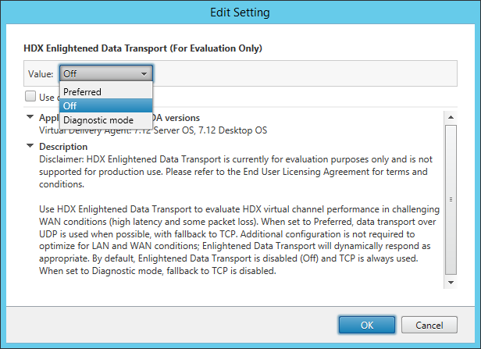
Adaptive Transport
Configuration
Preferred =
EDT first; fallback to TCP
Off =
Never Use EDT; only TCP
Diagnostic =
Always use EDT; no TCP

Slide 46
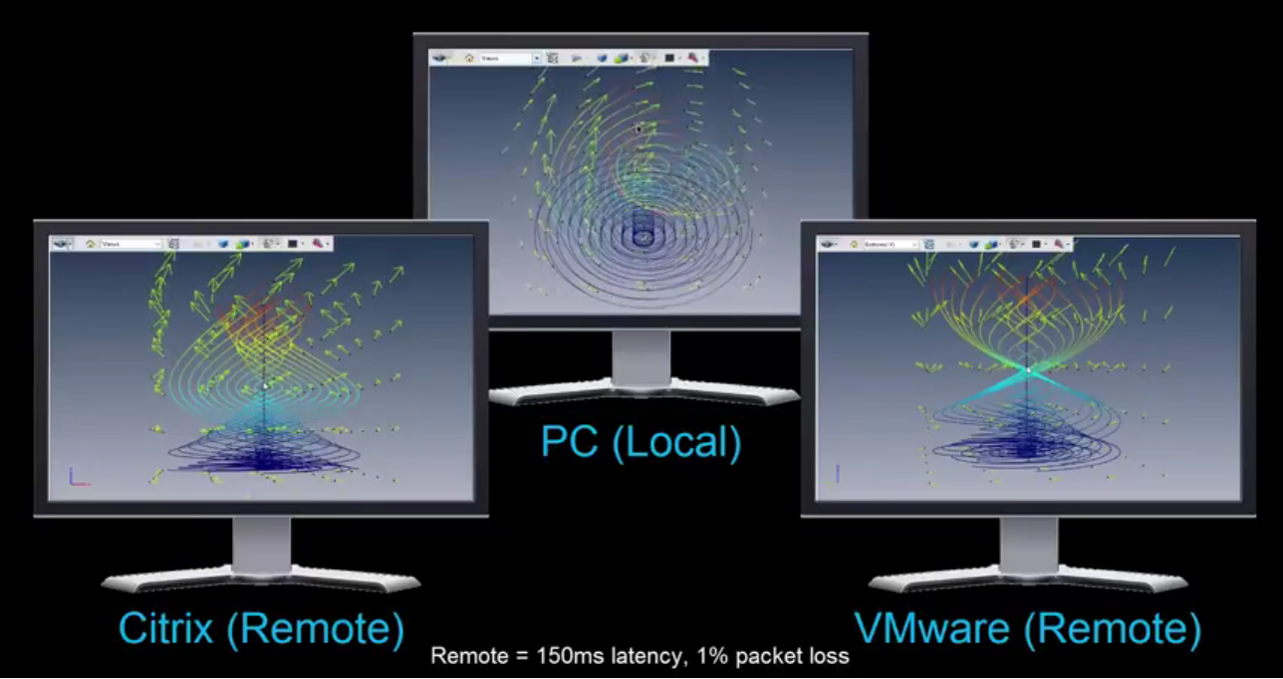
Enlightened and Adaptive Transport
Demo: Application Responsiveness
Demo Video: https://www.youtube.com/watch?v=OzYhyXPzMAI
Notes:
In this first example, we show how an application performs where the endpoint connects to a VDI desktop where the connection has 150ms and 1% packet loss. The PC, on the other hand, is our baseline, where the application and user run locally.
Note, there are no WAN optimization technologies or other optimizations in place across the 3 different tests.

Slide 47
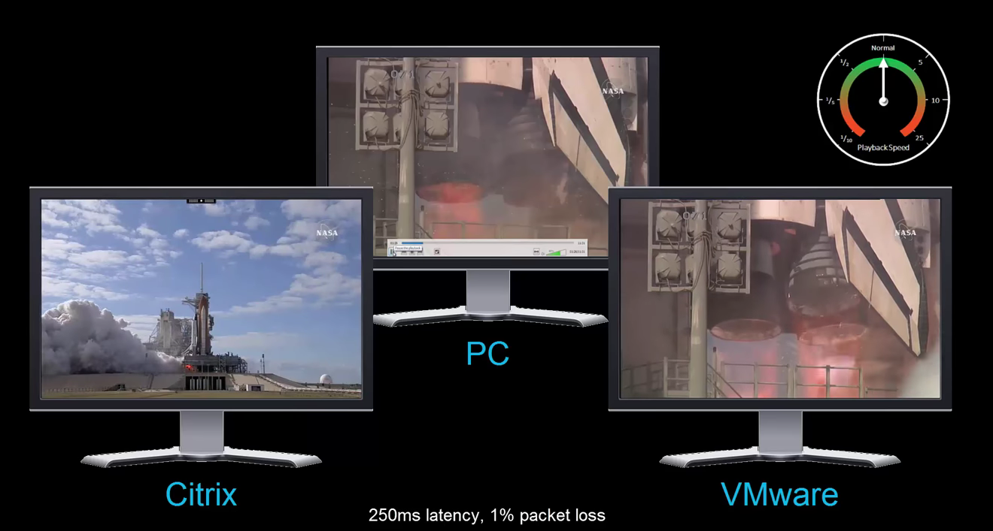
Enlightened and Adaptive Transport
Demo: Video Performance
Demo Video: https://www.youtube.com/watch?v=6dDOLomIjXc
Notes:
In the second example, we show how a video performs where the endpoint connects to a VDI desktop where the connection has 250ms and 1% packet loss.

Slide 48
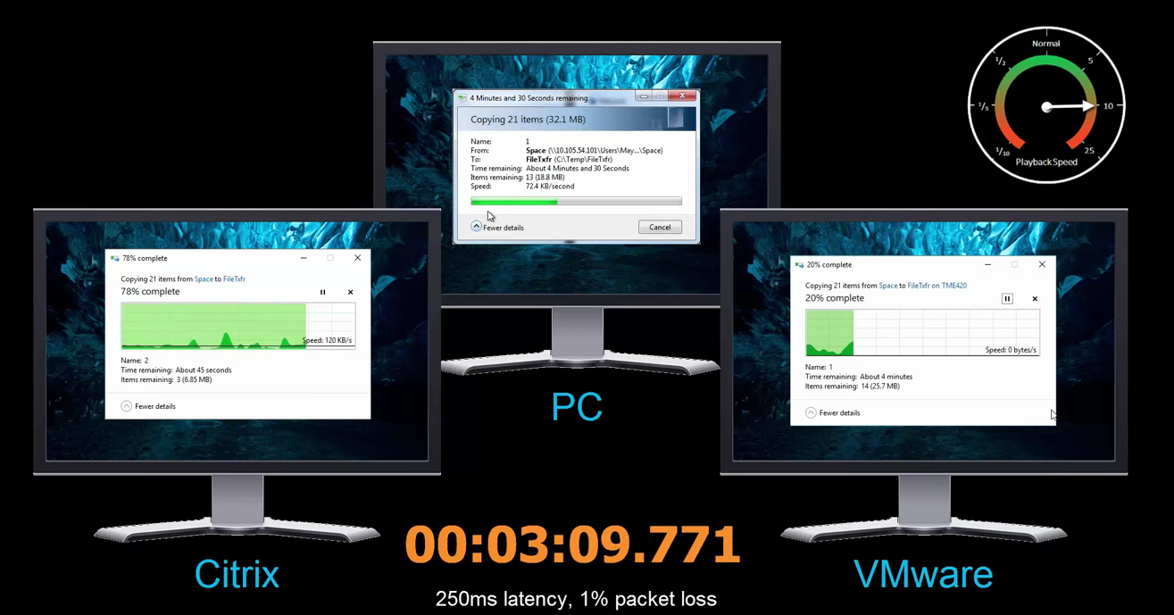
Enlightened and Adaptive Transport
Demo: File Copy Performance
Demo Video: https://www.youtube.com/watch?v=QfD-TMDDt54
Notes:
And In the third example, we show how how long it takes to copy files across a WAN connection with 250ms latency and 1% packet loss. This example truly demonstrates the impact Adaptive Transport has on the user experience.

Slide 49
Adaptive Transport
Design Considerations
Version 1
  Framehawk runs over UDP
  ICA switches between TCP/EDT

Slide 50
Contextual and Embedded Security
SmartAccess for Mobile

Slide 51
SmartAccess for Mobile
SmartAccess Policy
Full Access
Restricted Access
No Access
Why
External User
(Personal Device)
Delivery Controller
External User
(Personal Tablet)
NetScaler
VDA
External User
(Smartphone)
External User
(Corporate Device)
Notes:
One way organizations increase security within their environment is to limit the level of access a user receives based on their endpoint device and current location.
[Click] For example, external users on corporate-managed endpoints might receive full access to their apps, desktops and data based on the SmartAccess policies applied by the XenApp/XenDesktop delivery controller
[Click] But the same user, who accesses the environment from an external location on a personal endpoint device might receive full access to Outlook, no access to a financial spreadsheet, and restricted access to the HR app (meaning that they are not allowed to print or copy files).
The analysis to determine what a user has access too can be based on device ownership, user location, registry scans, file system scans, antivirus scans, etc.
[Click] But what happens when external users access the environment on tablets and smartphones?

Slide 52
SmartAccess for Mobile
SmartAccess Policy
Full Access
Restricted Access
No Access
Why
External User
(Personal Device)
Delivery Controller
External User
(Personal Tablet)
NetScaler
VDA
External User
(Smartphone)
External User
(Corporate Device)
XenMobile Server
Notes:
When XenApp and XenDesktop are integrated with XenMobile, the SmartAccess policies extend to support mobile devices, like tablets and smartphones.
[Click] When a XenApp/XenDesktop resource is launched from Secure Hub, the request is sent to the XenMobile Server, which then forwards that request to the XA/XD Delivery controller. The response dictates the level of access the endpoint device receives.
[Click] While the user’s smartphone, which is jailbroken, could be denied all access to the user’s desktops, apps and data.

Slide 53
SmartAccess for Mobile
Overview
Compliance Tag
Mobile User
(SecureHub and Receiver)
XenMobile
StoreFront
Delivery Controller
Notes:
It we look closer at how this process works, we first start with Secure Hub running on a mobile device.
[Click] Secure Hub requests application enumeration from XenMobile
[Click] When making the enumeration request to StoreFront, XenMobile injects the device-compliance tag into the request (as an HTTP header). These tags are signed (and encrypted) using a signing certificate on the XenMobile server.
[Click] StoreFront validates the signature (and decrypts) these tags and relays the tags to XA/XD controller.
[Click] XA/XD filters out the applications based on the provided user-context and tag and the application details are sent back to WH (via StoreFront and XenMobile).
When a user launches the application, the launch request is sent to XA/XD via the same path (WH --> XenMobile --> StoreFront --> XA/XD). The compliance tag is inserted by XenMobile before making PNA launch requests to StoreFront. If the launch is permitted, the launch info (an ICA file) is sent to WH.

Slide 54
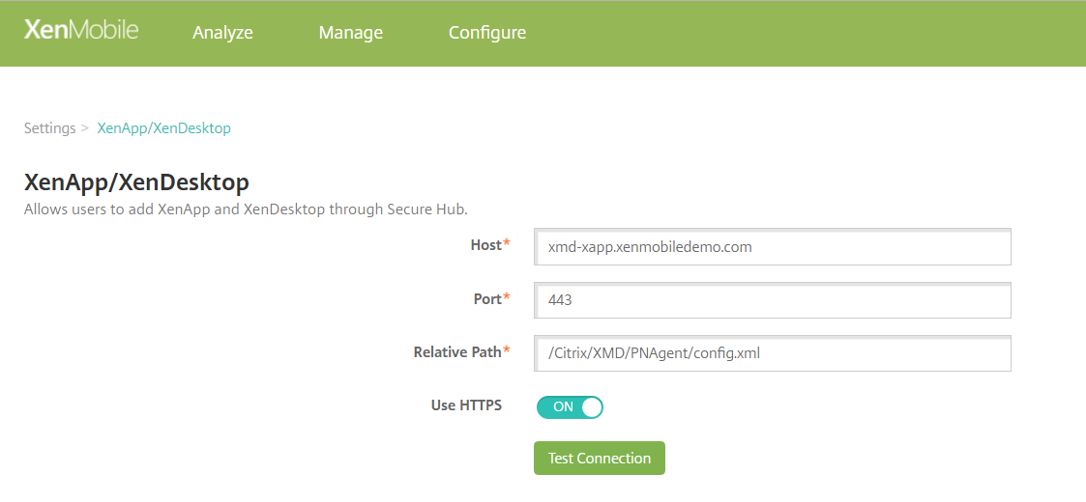
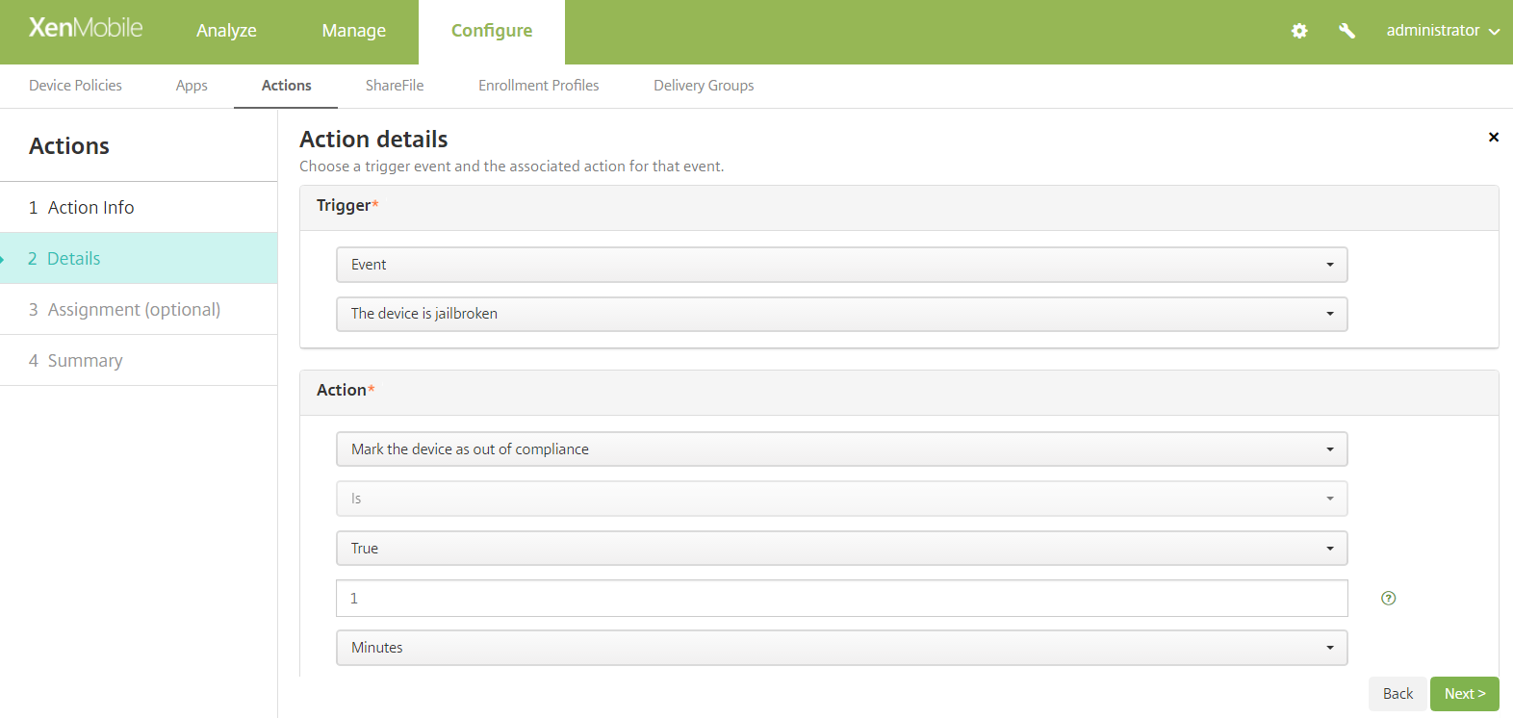
SmartAccess for Mobile
Configuration - XenMobile
Configure Settings > XenApp/XenDesktop
  Host = Delivery controller
  Path = PNAgent store URL
Create Automated Action to set Compliance
  Trigger = Event > The device is jailbroken
  Action = “Mark the device as out of compliance”

Slide 55
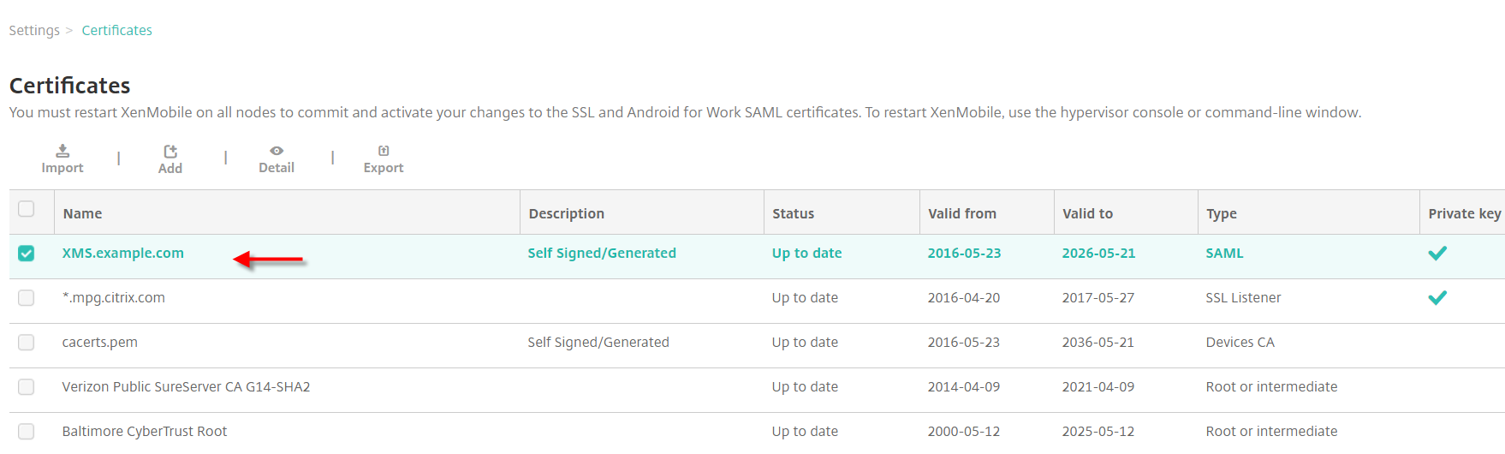
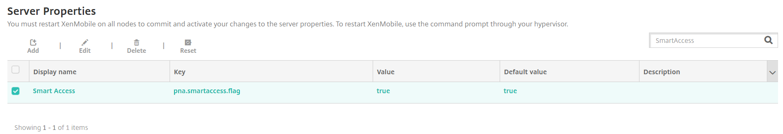
SmartAccess for Mobile
Configuration - XenMobile
Add custom key to Server Properties
  Key=pna.smartaccess.flag
  Value=true
  (XM Service must be enabled by the Cloud Ops team)
Export SAML Certificate
  Do not export the private key
  (Type = PEM)

Slide 56
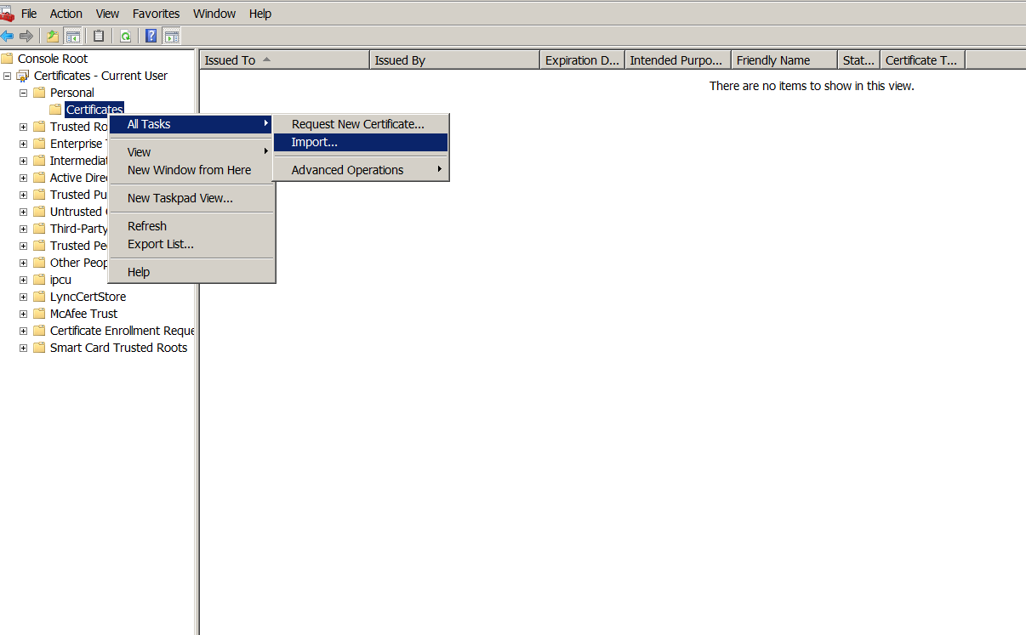
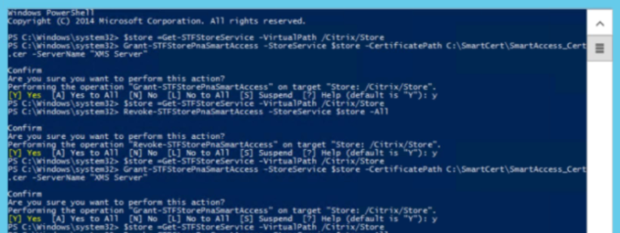
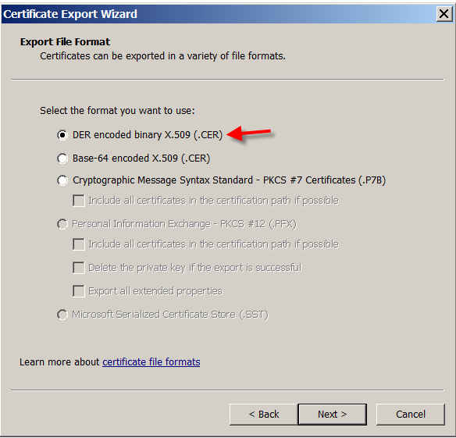
SmartAccess for Mobile
Configuration - StoreFront
Import XenMobile SAML cert into StoreFront
Convert cert from PEM to CER
  Import in MMC > Certificates
  Export as .DER
Import into StoreFront with PowerShell
  Grant-STFStorePnaSmartAccess –StoreService $store –CertificatePath “C:\Smart Access_Cert\xms.cer” –ServerName “XMS server”

Slide 57
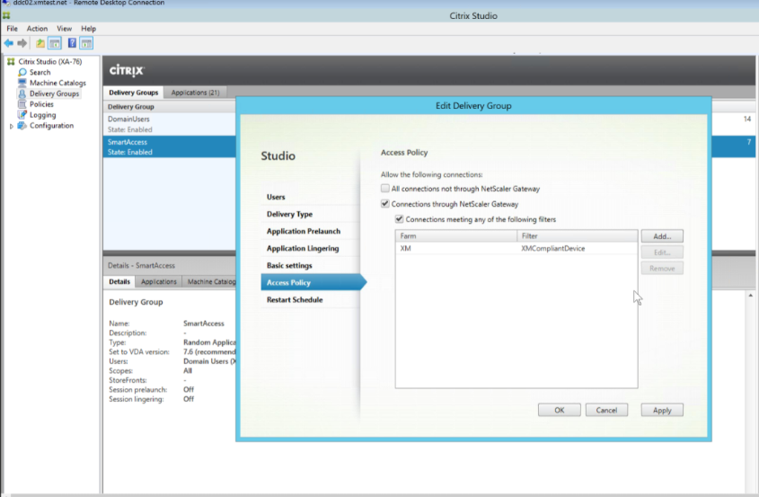
SmartAccess for Mobile
Configuration – Delivery Controller
Create desired Access Policy
  Set Farm Name
  Set Filter = XMCompliantDevice

Slide 58
SmartAccess for Mobile
Design Considerations
V1 limited to
  Allow access to a XenApp/XenDesktop resource
  Deny access to a XenApp/XenDesktop resource

Slide 59
Contextual and Embedded Security
StoreFront SAML Authentication

Slide 60
StoreFront SAML Authentication
Why
SAML/OpenID Trust
Identity Provider
External User
NetScaler
Federated
Authentication Service
Microsoft
Certificate Services
StoreFront
Active Directory
Internal User
VDA
Notes:
In the 7.9 release, XenApp and XenDesktop added user authentication support for 3rd party identity providers with the introduction of the Citrix Federated Authentication Service.
[Click] The user would connect to NetScaler to log on.
[Click] The logon request is sent to the Identity Provider via the SAML trust, which accepts the user’s logon credentials and validates against its Identity Data Store.
[Click] If accepted, NetScaler forwards the request to StoreFront, which tries to authenticate against Active Directory
[Click] As users are unaware of their AD credentials, StoreFront contacts the Citrix Federated Authentication Service, which creates a virtual smartcard for the user.
[Click] In order to support Smartcard authentication, Active Directory automatically generates a certificate via Microsoft Certificate Services that the user’s virtual smartcard utilizes.
[Click] When the user initiates a session, NetScaler sends the ICA traffic to the VDA.
[Click] The user automatically logs onto Windows, but instead of going directly to Active Directory, the logon is done with the virtual smartcard via the Federated Authentication Service.
[Click] But what happens when you have an internal user? As NetScaler is responsible for authenticating to the 3rd party identity provider, internal users must traverse NetScaler. Also, what happens if NetScaler is not part of the environment?

Slide 61
StoreFront SAML Authentication
Overview
SAML Trust
Identity Provider
StoreFront
Federated
Authentication Service
Microsoft
Certificate Services
Active Directory
Internal User
VDA
Notes:
With 7.13, the options are different.
[Click] Internal users authenticate directly to StoreFront.
[Click] StoreFront directly authenticates users, via SAML, to other identity providers.
[Click] After this, the rest of the process follows the same flow as external users going through NetScaler.

Slide 62
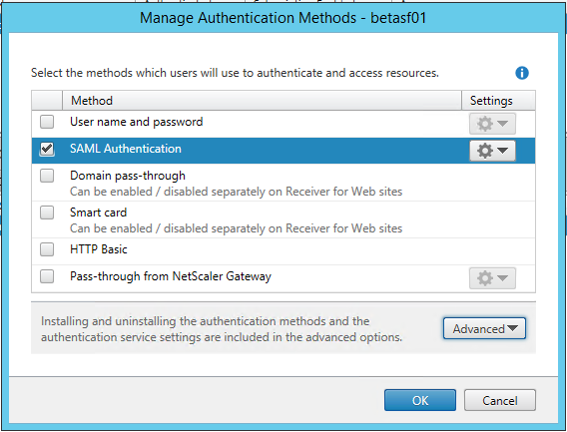
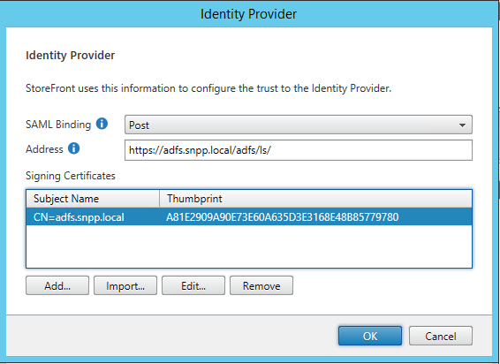
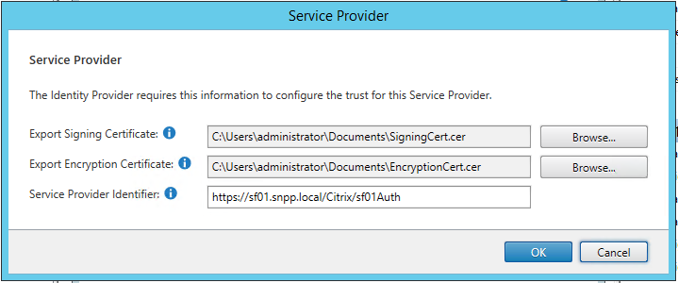
StoreFront SAML Authentication
Configuration
Add SAML authentication to store
Configure Identity Provider
Configure Service Provider
Notes:
In order to setup SAML authentication for StoreFront, the SAML Authentication must first be added to the store.
[Click] The Identity Provider information must be added, which includes the Identity Provider’s SAML logon page as well as the certificate’s common name and certificate thumbprint
[Click] Finally, the Service Provider information is required, which is the StoreFront server. A Signing and Encryption certificate will get created.

Slide 63
StoreFront SAML Authentication
Design Considerations
Following SAML 2.0 IdP are supported
  NetScaler Gateway (configured as IdP)
  Microsoft AD FS v2.0 (Windows Server 2008R2)
  Microsoft AD FS v3.0 (Windows Server 2012R2)
  Microsoft AD FS v4.0 (Windows Server 2016)
Other SAML 2.0 IdP should work

Slide 64
Simple and Scalable Management
XenServer Patching and Updates

Slide 65
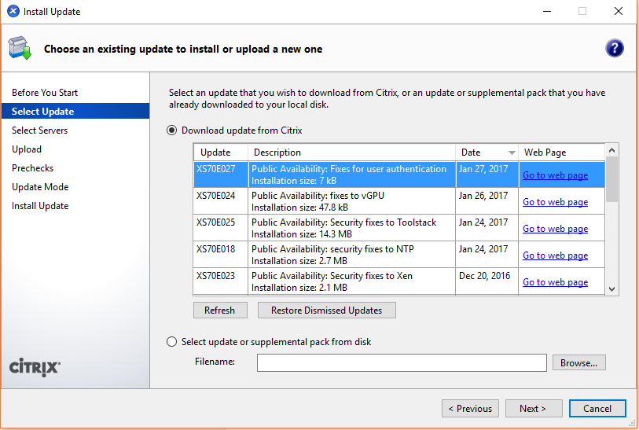
XenServer Patching and Updates
Why
Current process
  Patch
  Wait
  Reboot
  Wait
  Patch
  Wait
  Reboot
  Wait
  Patch
  Wait
Notes:
Patching XenServer is an easy process, but it is time consuming as patches are installed one-by-one, with many requiring reboots.

Slide 66
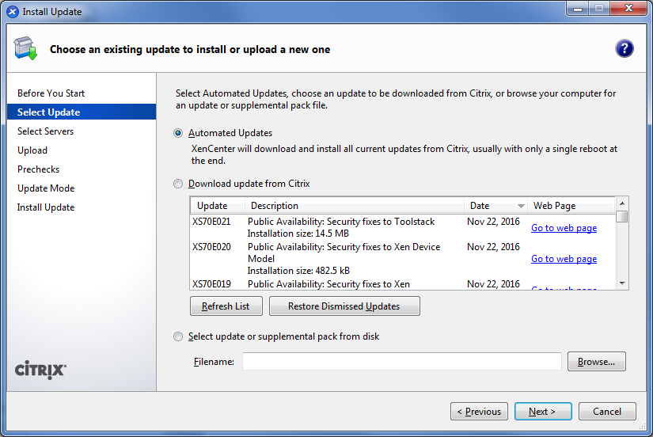
XenServer Patching and Updates
Overview
Apply multiple patches
Dependencies satisfied
Streamlines order
In-place patches
(no reboots)
Notes:
Apply multiple fixes to a host at one time: no longer have to install one by one
Reboot hosts the minimum number of times required: normally only need one reboot after installing many hotfixes
Install all hotfixes in the correct order: dependencies now automatically satisfied, and minimum set of hotfixes to get fully up to date is downloaded
Many fixes can be binary patched “in place”, i.e. without the need for a reboot
Hence, going forward, every hotfix will include the RPM to replace the binaries on disk, and a live patch
Note that there are likely to be rare fixes that cannot be live patched; we will try hard!

Slide 67
XenServer Patching and Updates
Design Considerations
License Requirements
  XenApp/XenDesktop (All Editions)
  XenServer Enterprise
Still change a patch requires reboot if patching Dom0 (minimal)

