Slide 1

What’s New in
XenApp & XenDesktop 7.13
Q1 2017 Current Release
February 16, 2017
  <Name>
    <Position>

Slide 2
XenApp and XenDesktop release strategy
Always the Latest
Citrix Cloud
Releases
(Every 2 weeks*)
New Feature Releases
Current Releases
(Quarterly*)
2017 Q1 | 2017 Q2 | 2017 Q3 | 2017 Q4
XenApp & XenDesktop 7.13 | XenApp & XenDesktop TBD |  | XenApp & XenDesktop TBD
*Estimates only, subject to change
Notes:
For perspective, here is a comparison of the different release trains and how they relate to the new Servicing Options. The XenApp and XenDesktop Service in Citrix Cloud will always have the latest and greatest features. Of course with Citrix Cloud, upgrading to the latest features and functionality is very easy because in most cases Citrix is doing all the upgrade effort for you, as we will maintain the management backbone hosted in the cloud. The other benefit to that release train is that new features are available quickly and often, and vetted on a large scale.
Current Releases (CRs) are basically what you have grown accustomed to. Citrix is providing access to the latest features and functionality as soon as they are available for on-premise deployments, giving you the option to deploy new features as quickly as possible. As related to Citrix Cloud, many of the individual features rolled out in Citrix Cloud are then packaged into an on-premises release that you can download and install in your datacenter.
Long Term Service Release (LTSR) is really the new kid on the block, a Long Term Service Release is the aggregate of many Current Releases and likely the last, feature rich release of a major version. For example, we released XenApp and XenDesktop 7.6, then FP1, FP2, FP3, making 7.6 FP3 features and functionality well vetted and proven to our customers, it was only at that point are we announcing an LTSR release of 7.6. The key thing to note is that there aren’t code differences between the components in 7.6 FP3 and the 7.6 LTSR release, it’s rather that the components of the LTSR release are eligible for the benefits of LTSR.

Slide 3
XenApp and XenDesktop releases
Always the Latest
Citrix Cloud
Releases
(Every 2 weeks*)
New Feature Releases
Current Releases
(Quarterly*)
Predictable Release Cycles
Long Term
Service Releases
(12-24 Months*)
2017 Q3
XenApp & XenDesktop LTSR * Will mostly contain features up to the 7.13 current release
*Estimates only, subject to change
Notes:
https://www.citrix.com/blogs/2017/02/01/xenapp-and-xendesktop-2017-release-schedule/
For perspective, here is a comparison of the different release trains and how they relate to the new Servicing Options. The XenApp and XenDesktop Service in Citrix Cloud will always have the latest and greatest features. Of course with Citrix Cloud, upgrading to the latest features and functionality is very easy because in most cases Citrix is doing all the upgrade effort for you, as we will maintain the management backbone hosted in the cloud. The other benefit to that release train is that new features are available quickly and often, and vetted on a large scale.
Current Releases (CRs) are basically what you have grown accustomed to. Citrix is providing access to the latest features and functionality as soon as they are available for on-premise deployments, giving you the option to deploy new features as quickly as possible. As related to Citrix Cloud, many of the individual features rolled out in Citrix Cloud are then packaged into an on-premises release that you can download and install in your datacenter.
Long Term Service Release (LTSR) is really the new kid on the block, a Long Term Service Release is the aggregate of many Current Releases and likely the last, feature rich release of a major version. For example, we released XenApp and XenDesktop 7.6, then FP1, FP2, FP3, making 7.6 FP3 features and functionality well vetted and proven to our customers, it was only at that point are we announcing an LTSR release of 7.6. The key thing to note is that there aren’t code differences between the components in 7.6 FP3 and the 7.6 LTSR release, it’s rather that the components of the LTSR release are eligible for the benefits of LTSR.

Slide 4


Release themes
XenApp and XenDesktop 7.13
User Experience
Admin Experience
“Ensuring User
Productivity”
“Easy to
Maintain”
Delightful user experiences doing more within the current infrastructure and expanded device support
Simplified setup and configuration, new use cases, and platform support

Slide 5


&
User Experience
Ensuring user productivity through delightful experiences
Adaptive Transport Technology
Bandwidth Improvements for Graphics Remoting
AMD GPU Support for HDX 3D Pro High-end Graphics
Video Encoding Offload on Intel Iris Pro Hardware
Expanded USB Device Support for Server-OS Sessions
Improved Support for Input of Asian Languages
Caching for PVS Streamed VMs on XenServer
Linux Seamless Published Applications

Slide 6
&
Admin Experience
Easy to setup and maintain so I can focus on strategic objectives
Authenticate to StoreFront with 3rd Party Identity Providers
Filter Sessions by Idle Time in Citrix Director
Improved Setup with NetScaler Gateway and StoreFront
Database High-Availability Options for Session Recording
AppDNA Performance Improvements
VDA Registration Optimizations
Linux VDA Support with Provisioning Services

Slide 7
Current Citrix Cloud promotions
Starter Pack
RemoteApp Replacement
Transition & Trade-Up
50% off 100 users for XenApp & XenDesktop Service
Available for 1, 2 or 3 years
ELA discounts apply
Ends June 30, 2017
Ends March 31, 2017
XenApp & XenDesktop Service at $15 pupm for every existing ARA seat
1 year only
More info in Sales IQ
More info in Sales IQ
Existing customers can transition or trade-up to XenApp & XenDesktop Service or Workspace Service up to 70% off
Resource Location limited to Azure
Includes Hybrid Rights for 2 years
End June 30, 2017
More info in Sales IQ
Only available for 3 years and min 500 users

Slide 8

User Experience

Slide 9



Ensuring user productivity through delightful experiences
Do more while slashing costs
Adaptive Transport
Bandwidth Reductions
AMD GPU Support
PVS and XenServer Caching
And much more…

Slide 10

High-performance, adaptive sessions
Also available with
Adaptive Transport Technology
Up to
10X
Up to
5X
Up to
2X
Up to
2X
Faster File Transfers
Faster Printing
More Responsive UI
Higher FPS Audio/Video
Notes:
Sales Messaging: Reduced costs with improved session performance and better adaptability to changing conditions all with less required administrative configuration that saves time. A significant advancement and strong driver for customers to upgrade from XenApp 6.5 and earlier 7.x releases.
------------------------------------
Customer Challenge: I need to ensure that sessions perform well for my users, especially over high-latency connections and when session conditions change.
Prior Handling: Various Citrix protocol options exist (Thinwire, Framehawk, etc.) with each one having its own benefits for certain connection scenarios.
Feature Description: A new Adaptive Transport engine for HDX maintains high performance across all virtual channels (graphics, client drives, printing, etc.) by intelligently adapting to different workloads and changing network conditions. It leverages a new Citrix transport protocol known as EDT which uses UDP as the primary data transport with automatic fallback to TCP when required. This results in higher throughput, improved session interactivity, greater adaptability for changing session conditions and less required policies to configure. Adaptive Transport was available in 7.12 in Tech Preview and now it is generally available. It is easily enabled via policy and there is minimal risk due to fallback behavior or by just making Thinwire default.
Compete: HDX already performs better than both PCoIP and Blast today. This enhancement offers broad compatibility, unlike VMware Blast Extreme, and up to 3x better performance than VMware in side-by-side tests.

Slide 11

Benefits of Adaptive Transport
Leverage existing hardware
Minimal policies to configure
Multi-monitor support
Accelerates all virtual channels
Secured by NetScaler Gateway

Slide 12

Up to 60% reduction in bandwidth use
Also available with
HDX display protocol enhancements
No loss in image quality
Also improves server scalability
Enabled by default
Backwards compatible with existing Receiver versions
Notes:
Pre-release blog: https://www.citrix.com/blogs/2017/01/11/hdx-next-cuts-bandwidth-by-up-to-60-yes-sixty-percent/
Sales Messaging: Cut network utilization costs while serving more users with new reduced bandwidth consumption. Enabled by default, this enhancement provides immediate, noticeable benefits to all customers.
------------------------------------
Customer Challenge: IT is always looking to reduce session bandwidth consumption to save costs, accommodate more users on their infrastructure and provide a great experience over WAN links.
Prior Handling: The latest Citrix Thinwire display remoting technology in XenApp and XenDesktop 7.12 is fairly efficient in bandwidth consumption and server resource utilization, but there is always room for improvement. Upon initially testing RDP 8.x on Windows Server 2016 and Windows 10, Citrix saw that it consumed 25-30% less bandwidth compared to Thinwire.
Feature Description: Thinwire display algorithms have been optimized to further reduce bandwidth consumption while improving server scalability. Improvements are enabled by default and there are no additional requirements including backward compatibility with existing Citrix Receiver versions.
Compete: 20-25% less bandwidth consumption compared with RDP. Less overall bandwidth consumption compared with VMware.

Slide 13

Experience rich, high-end graphics on AMD GPUs
Also available with
HDX 3D Pro support for AMD
Ideal for designers, engineers, and power users
  CAD, CAM and 2D/3D applications
  Web browser acceleration for images and videos
Enterprise-grade featureset
  Multi-monitor support (up to 6)
  Console blanking
  Custom resolution
  High frame-rate
Supported on all hypervisors
  Pass-through on XenServer and Hyper-V
  Pass-through and MxGPU on ESX
Notes:
Sales Messaging: Enable high-end graphics possibilities on AMD-based graphics hardware.
------------------------------------
Customer Challenge: Certain users require high-end, professional graphics within their sessions to complete their job. I need to accommodate them using our current (or soon-to-be-purchased) hardware.
Prior Handling: AMD GPUs have been supported within XenApp server-based sessions only, but not within VDI sessions for HDX 3D Pro.
Feature Description: AMD GPUs are now supported for use with HDX 3D Pro as we are leveraging the latest graphics APIs provided by AMD. This provides rich graphics to address a variety of use-cases.
Compete: VMware has already had this feature. Additional details TBD.

Slide 14
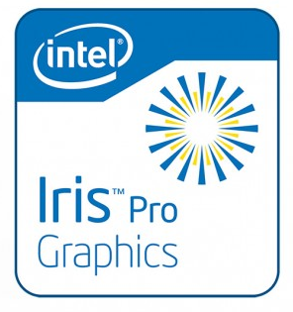
Improved performance and scalability with Intel graphics
Also available with
H.264 hardware encoding with Intel Iris Pro
Increased server scalability and user density
Applicable to both server and desktop VDAs
Ideally paired with selective H.264 graphics setting
  Best overall performance, scalability and user experience
Notes:
Sales Messaging: Improve performance and increase server scalability when using hardware based on Intel Iris Pro graphics.
------------------------------------
Customer Challenge: Provide the best possible user experience while maintaining server scalability using the hardware that we currently own (or plan to purchase).
Prior Handling: Intel Iris Pro graphics has been supported with HDX 3D Pro since XenApp and XenDesktop 7.9 as well as the ability to leverage the GPU for server-based sessions. H.264 encoding still had to be performed within software, however, despite the platform having the necessary offload for this capability. This impacted server scalability and session performance.
Feature Description: Offload CPU-intensive H.264 video encoding to the Intel Iris Pro hardware for the best possible user experience and improved server scalability.
Compete: VMware can only use NVIDIA NVENC for H.264 encoding. By offering H.264 encoding for Intel Iris Pro, we provide customers with lower CPU consumption and higher user density all at an attractive price point.

Slide 15
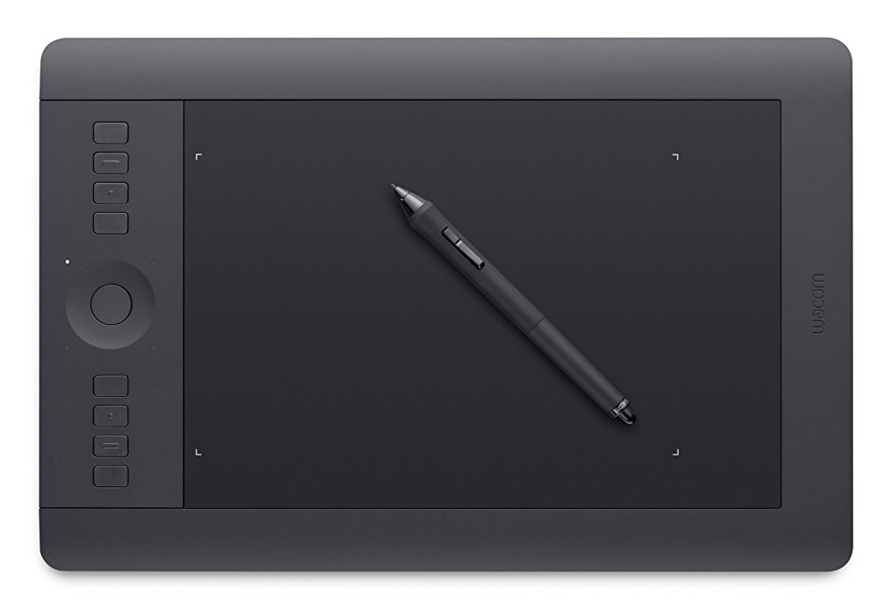
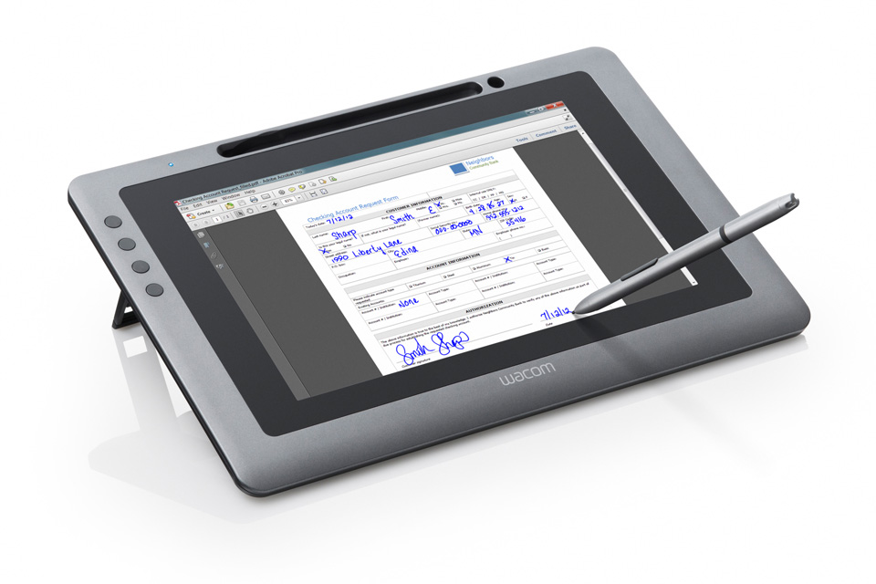
Expanded USB device support for XenApp sessions
Also available with
Drawing tablets that utilize mouse functionality
Wacom PTH-651
Wacom DTU-1031
Notes:
Sales Messaging: Reduce infrastructure and licensing costs with support for a broader range of specialty USB tablet devices within XenApp sessions. Prevents the need to introduce VDI to these users.
------------------------------------
Customer Challenge: Users, such as artists and designers, rely on drawing tablets to do their jobs. These devices need to be made available within virtual app and desktop sessions and provide similar functionality and performance as when operated locally.
Prior Handling: In 7.6 FP3 we introduced the USB policy setting and optimizations for specifying interactive versus capture mode. Interactive is ideal for drawing tablets and capture is ideal for signature tablets to best handle the traffic accordingly by function. In 7.11, we introduced generic USB redirection for mass storage devices in XenApp which allowed devices to appear as though they were physically connected to the server for the best possible experience and broadest device and application support. However, drawing tablets that make use of mouse functionality were not supported over generic USB redirection on server machines. They do work on desktop-OS machines though so admins needed to utilize VDI in order to support them which consumed additional resources and required a XenDesktop license.
Feature Description: USB device support has been further expanded within XenApp sessions. Now certain drawing tablets that make use of mouse functions can be used within multi-user sessions to server operating systems. Recommended for use with the latest Receiver for Windows 4.7 which has updates to properly handle when the local client is locked.
Compete: TBD

Slide 16

Enhanced support for Asian languages
Generic client Input Method Editor (IME)
Uses IME from the client device as opposed to the remote session
  Additional language choice for users
  More convenient for touch-enabled devices
  Enhances security
  Less configuration for admins
  Soft keyboard for Windows 10 and 8
Notes:
Sales Messaging: Improved user experience with Asian languages in sessions.
------------------------------------
Customer Challenge: I have users in the APAC region and need to ensure that they are able to easily work with their native Asian languages within sessions.
Prior Handling: The Input Method Editor (IME) for Asian language input was used from the virtual desktop or server as opposed to from the client. This resulted in compatibility and usability challenges – especially on mobile devices.
Feature Description: The local Input Method Editor (IME) from the client device is now used resulting in broader compatibility and a better overall experience when working with Asian languages.
Compete: TBD

Slide 17
Improve VM performance while reducing system load
PVS-Accelerator for Provisioning Services and XenServer
Cache PVS VM data on XenServer hosts
Available with…
  Provisioning Services 7.13
  XenServer 7.1
Significant performance advantages
  93% lower CPU utilization on PVS server
  92% drop in network utilization
  26% faster boot times
Notes:
Sales Messaging: Improved performance and reduced resource and network consumption. A unique differentiator for XenApp and XenDesktop running on XenServer.
------------------------------------
Customer Challenge: I stream hundreds or thousands of server and desktop VMs that users can connect to. I need to ensure that they perform well while also minimizing resource consumption within the infrastructure.
Prior Handling: Each VM streamed with Provisioning Services needed to come down over the network from the PVS Server to the hypervisor hosts. Even though most of the bits from the same PVS image file were needed across all target machines, they needed to be streamed independently over the network from the PVS Server resulting in network and PVS Server resource consumption.
Feature Description: PVS VM data streamed to XenServer hosts can be cached on the host for use by other VMs as required. This significantly reduces resource consumption on the PVS Server while also minimizing network utilization and providing improved VM performance.
Compete: TBD

Slide 18

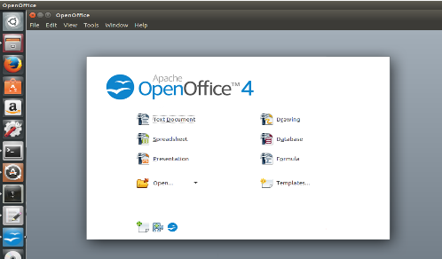




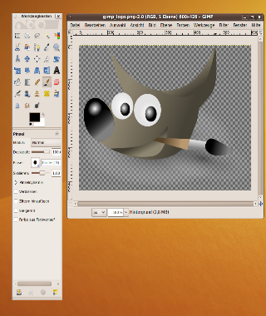




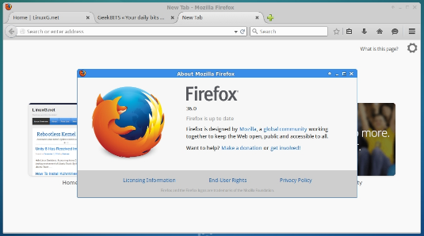
Integrated Linux applications on any device
Also available with
Linux seamless published applications
Notes:
Sales Messaging: Improved user experience when delivering Linux applications to any device. Expanded Linux integration makes the platform even more attractive to customer to take advantage of the flexibility and potential cost-savings of Linux.
------------------------------------
Customer Challenge: I need to deliver Linux applications to some of my users while ensuring a great and familiar experience.
Prior Handling: XenApp and XenDesktop 7.11 along with the Linux VDA 1.4 introduced support for publishing Linux applications in a non-seamless, windowed mode. Users could switch between published applications as required within the single window; however, each running application wasn’t fully integrated within the local desktop, taskbar, etc. This was not an optimal experience for users and not how Windows-based applications behaved.
Feature Description: Published Linux applications can now be run seamlessly and integrated within the local user’s desktop. This results in a much more familiar experience for users. Organizations can save on Windows licensing costs by delivering Linux apps to Windows and other endpoint platforms.
Compete: VMware only has Linux VDI desktops. They do not offer hosted-shared desktops or published applications for Linux. Our solution provides more flexibility, scalability and a better overall user experience (e.g. deliver an integrated Linux application to a local device without having to launch a full VDI desktop).

Slide 19

Admin Experience

Slide 20




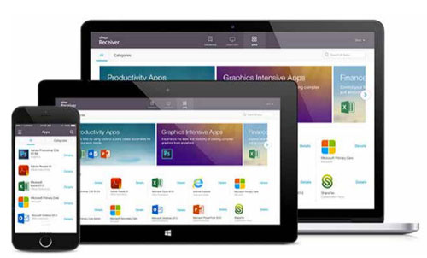
Easy to setup and maintain
Save time and focus more on what matters
Linux Provisioning
Improved NetScaler Gateway
and StoreFront Setup
Easily Identify Idle Sessions
Expanded Authentication
And much more…

Slide 21

Easily provision Linux server machines
Support for Linux VDAs with Provisioning Services 7.13
Linux vDisk on
Provisioning Server
Target VDA Machines
Notes:
Sales Messaging: Save time and ensure consistency when working with the Linux platform using Provisioning Services 7.13 with XenApp and XenDesktop 7.13.
------------------------------------
Customer Challenge: VDA server machines, whether Windows or Linux, often need to be provisioned in the hundreds and made available to users while ensuring proper consistency and lifecycle updates when required.
Prior Handling: Linux server VDAs needed to be manually provisioned using hypervisor methods or 3rd party or in-house tools as XenApp and XenDesktop provisioning methods did not support Linux.
Feature Description: Provisioning Services now supports Linux as a target OS platform for servers so Linux VDAs can be provisioned by this method. This offers single-image consistency, ease of updates with image versioning and high scalability.
Compete: VMware only includes automated full-clone “image management.” They do not have a solution for non-persistent Linux VMs. Our solution offers agility, scale and ease of management all at a lower cost.

Slide 22






Authenticate to resources via a 3rd party provider
SAML authentication through StoreFront
SAML
Notes:
Sales Messaging: Additional flexibility for using logging in with 3rd party credentials to access resources.
------------------------------------
Customer Challenge: I need users to authenticate to resources with non-AD credentials across several connection scenarios.
Prior Handling: The Federated Authentication Service (FAS) was introduced with XenApp and XenDesktop 7.9. It allows authentication from various non-AD providers to app and desktop resources through the use of NetScaler. It was not possible to use this solution without a NetScaler, such as internally, connecting directly to StoreFront.
Feature Description: StoreFront can now directly handle SAML authentication with 3rd party identity providers – NetScaler is not required. This is available for web browser access as well as Windows Receivers.
Compete: TBD

Slide 23


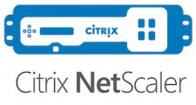
Enhanced NetScaler Gateway integration
Easily import multiple NetScaler Gateway configurations to StoreFront
1
2
3
Export one or more
NetScaler Gateway
configurations to a file
Import configuration
file from NetScaler
into StoreFront
Save time and ensure
consistency while preparing
environment for external access
Notes:
Sales Messaging: Save time and reduce the possibility of errors while preparing the environment for external access.
------------------------------------
Customer Challenge: Configuring multiple NetScaler Gateways with StoreFront for providing external access can be time consuming and prone to errors.
Prior Handling: NetScaler Gateway 11.1 allows the exporting of configuration data to a file. This file could be imported within StoreFront; however, multiple vServers/deployments was not supported for import within StoreFront.
Feature Description: Exported NetScaler Gateway configuration files that contain multiple vServers/deployments can now be imported to StoreFront. This is the preferred, simplified way to handle the setup process.
Compete: VMware doesn’t have their own external access appliance so they need to work with other vendors like F5. This means they simply cannot integrate as well as we can.

Slide 24

Optimize environment usage with Citrix Director
Also available with
Filtering for idle/hung sessions
Sessions in an idle/hung state consume resources and licenses
  CPU and RAM on the host as well as Citrix and Microsoft licenses
Many companies have licenses that match shift employee count
  Additional unused sessions may prevent new valid sessions from connecting
Now you can easily filter by idle session time in Citrix Director
  Available for published application sessions
  Logoff or disconnect sessions as required
Notes:
Sales Messaging: Conserve environment resources with improved visibility of unused sessions.
------------------------------------
Customer Challenge: I need to minimize sessions that are idling or hung as they consume infrastructure resources as well as licenses and may prevent new users from connecting.
Prior Handling: The Citrix Director console doesn’t show sessions that are idling making it difficult for admins to determine which ones are in this state and take appropriate action on them (e.g. logoff or disconnect).
Feature Description: Director now allows admins to identify sessions that are idling and filter by the idle time. They can then take appropriate action, logoff or disconnect, as required. This filtering is available for all published application sessions.
Compete: TBD

Slide 25


Built-in enhancements to reduce infrastructure impact
Also available with
VDA registration optimizations
Delivery Controllers
Virtual Delivery Agents
Notes:
Sales Messaging: Minimize environment impact during shift changes and maintenance operations. Improved architecture for bursting to the cloud.
------------------------------------
Customer Challenge: When large numbers of VDA machines reboot in the environment, it creates a load on our infrastructure and the overall impact needs to be minimized to ensure users can connect. Additionally, when bursting to the cloud with an on-premise infrastructure, we need to minimize WAN traffic between the cloud-based VDAs and on-premise delivery controllers.
Prior Handling: All VDA machines that users connect to, both servers and desktops, need to register with the delivery controllers upon initial startup and reboots to establish themselves as available for connections. Additionally, there is periodic communication that takes place between VDAs and controllers during events such as user logons. In environments with large numbers of simultaneous registrations, as well as hybrid environments, this can potentially have an impact on network, performance and availability.
Feature Description: The VDA registration and communication processes have been optimized resulting in less sent data during event updates between VDAs and controllers. This benefits all environments – especially large ones and hybrid ones.
Compete: TBD

Slide 26
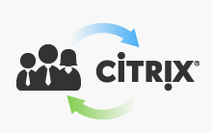

What’s new in StoreFront 3.9
SAML Authentication
NetScaler Gateway
Configuration Import
Support for the Customer Experience
Improvement Program
Notes:
SAML Authentication and NetScaler Gateway Configuration Import have both been previously covered on earlier slides.
The Citrix Customer Experience Improvement Program (CEIP) has been expanded to include StoreFront. CEIP is a way for anonymous product data to be sent in to Citrix for us to better understand how our products are being used including what features and configuration options are most common. This is important data that is used when planning future product releases. Customers should always be encouraged to enabled CEIP in their implementations as a way for them to essentially vote to us on what features and configurations are most relevant to them. For more information, refer to https://www.citrix.com/community/cx/ceip.html.

Slide 27

Linux VDA 7.13
Also available with
Seamless published apps
HDX Insight support
Support for Citrix Insight Services
Client IME support for Asian languages
Easy installation support
HDX 3D Pro on Non-NVIDIA grid cards (Experimental)

Slide 28

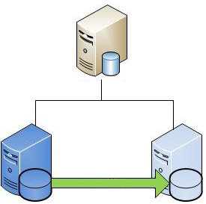
High-availability for recorded sessions
Platinum
Session Recording 7.13
Support for the following SQL HA options…
AlwaysOn Availability Groups
Database Mirroring
Notes:
High-availability for Session Recording ensures that sessions are able to get recorded as well as session playback.

Slide 29

Save time analyzing applications for compatibility
Platinum
Performance improvements in AppDNA 7.13
64
64-bit Application
Faster OS and
App Imports
Notes:
AppDNA is a great tool when planning Win10 and Server 2016 migrations

Slide 30

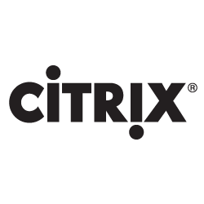
Enhanced System Center integration
Platinum
SCOM Management Packs 3.11
Tested scalability now 25K VDAs per deployment
Localization
  Spanish
  French
  German
  Japanese
  Simplified Chinese
+
Notes:
97% of surveyed customers and partners who have downloaded the SCOM packs would recommend them to others. https://www.techvalidate.com/tvid/C8C-85C-A78

Slide 31




New Receivers
Also available with
Receiver for Windows 4.7
EDT v1 support (next-gen HDX)
ACR/SR policy consistency
Receiver for Linux 13.5
Multi-stream ICA
HTML5 video redirection
Gstreamer 1.x support
Receiver for Mac 12.5
EDT v1 support (next-gen HDX)
Thinwire/3D Pro performance improvements
Hot bitmap caching
Receiver 7.2 for iOS
EDT v1 support (next-gen HDX)
Feature flags
Custom screen resolutions
StoreFront mandatory apps

Slide 32

Related offerings

Slide 33




What’s New in XenServer 7.1
Committed, Enterprise, Integrated, Secure
LTSR and aligned product lifecycle dates
XenApp/XenDesktop entitlement change
  All XA/XD customers entitled to XenServer Enterprise
PVS-Accelerator
  Reduces network traffic and improves boot times
Live-Patching
  Apply updates to XenServer hosts without downtime
Automatic Updates
  Automatically downloads hotfixes for deployment across multiple hosts
Bitdefender HVI
XenCenter Conversion Manager migration of Linux VMs
Nutanix HCI support for XenServer
“Better protect against advanced
and zero-day attacks.”
Notes:
https://www.citrix.com/blogs/2017/02/09/announcing-the-first-ever-hypervisor-security-layer-only-available-with-xenserver/

Slide 34
Smart Tools
Long Term Service Release (LTSR) compliance checks
New support for XenApp Essentials
Simplify day-to-day operations
Use-case specific micro-services
For on-premises and public cloud
Delivered through Citrix Cloud
Get Started Today:
smart.cloud.com
Smart
Check
Smart
Scale
Xen Family
NetScaler
ShareFile
Smart
Migrate
Smart
Build
Notes:
Smart Tools entitlement for XA/XD perpetual or on-premises subscription requires Select software maintenance.
Only XA/XD Platinum customers have access to Smart Scale.

Slide 35
Introducing Customer Success Services
Citrix Support used to mean technical assistance and regular version updates. Now it means a whole lot more.
Our new offerings deliver new exclusive features
Expert guidance
Proactive monitoring
Unlimited enablement
Award winning technical support and maintenance
Real-time contact with Citrix experts and best practices for assisting with planning new deployments, upgrades, and migrations
Exclusive use of tools, analytics, adoption insights, and cloud services enabling proactive monitoring and issue prevention
Unlimited online training so you and your organization can continuously build and develop skills
Anytime access to deep expertise for installation, configuration, and problem resolution, plus product version updates and upgrades
Notes:
Customer Success Services combines everything you need to accelerate adoption and fully realize your business goals; guidance, monitoring, enablement and award winning support.
https://www.citrix.com/support/citrix-customer-success-services.html

Slide 36
You’ll soon be able to choose from three tiers of service
Various packages to help you realize your business goals
Select Services | Priority Services | Priority Plus Services
A completely redesigned entry-level package full of industry-leading value-added features, including the fastest response times in the industry. | Personalized and proactive care with assigned account managers and technical experts delivering a priority level of service. | Offers a truly customizable service with our highest level of preventative care, enhanced monitoring services, and fastest restoration times.
Available Now
Coming July 2017
Notes:
https://www.citrix.com/support/citrix-customer-success-services.html
Customer Success Services starts with the core component of access to software version updates and upgrades. We then added a choice of tiered offerings that combine the key customer success elements of guidance, enablement, award-winning support, and proactive automated monitoring.
The Select edition will replace our current Software Maintenance offering and will be priced at the same price point. Select will introduce a completely redesigned entry-level package, building on 24x7 telephone and eservice support, plus brand new product and services exclusive to Select customers, such as the fastest response times in the industry, access to our entire catalog of commercial eLearning, access to our Consulting best practices materials via our online Knowledge Center, as well as tools and cloud solutions to assist with optimization, configuration and basic automated monitoring.
Our Priority package is targeted at our larger corporate and enterprise customers who need business critical support capabilities. It builds on our Select offering by introducing assigned technical account managers backed by an assigned team of deep technical resources intimately familiar with our customer’s environment, and priority routing and queuing for even faster response and restoration times.
Lastly, Priority Plus will introduce a Mission Critical level of support for customers who need a truly customizable service. Stay tuned for additional details coming in 2017 on Priority and Priority Plus offerings.

Slide 37



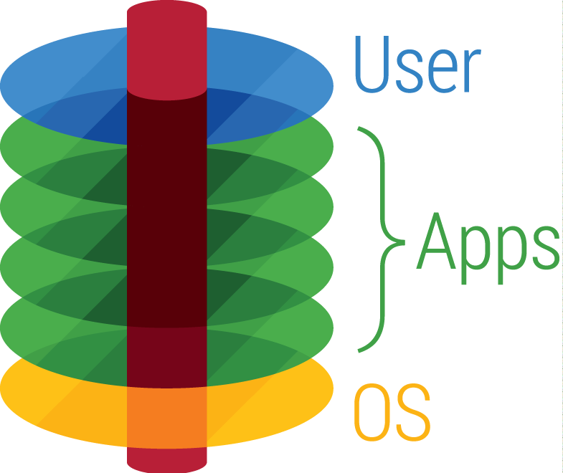

App Layering
100% app compatibility
Solves application AND image management
Best login performance
Seamless integration with native platform tools
XenApp session personalization
Portable to any hypervisor
Portable to cloud, only Azure-certified app layering solution
Layered Images™
Standard images built or updated before VM-boot from selected OS and App layers
Elastic Layers™
App and User layers delivered at login for dynamic customization of floating VDI pools and XenApp sessions
All Editions
Platinum Editions
Coming soon!
Notes:
Take the competition head-on. Mention App Volumes, App Disk, LL Labs FlexApp. Explain that the reason we have more customers than all of them combined and we won both industry awards over them are:
Only solution that offers full app compat. Why go with a solution that can manage all of your apps the same way?
Only solution that solves image management. OS layering, below Windows architecture. They don’t. You’re always going to have multiple images. But with Unidesk, you don’t have to worry about managing them
Only solution that offers choice of Layered Images or Elastic Layering to optimize login performance
Only solution that snaps into native tools PVS/MCS/Composer/Clones to make integration seamless. You already use these tools to manage image delivery. Now Unidesk enables you to manage image content.
Only solution that can customize XenApp shared hosted desktops with different apps. You can now extend XenApp and stop locally installing apps on PCs – get out of PC Refresh game, save huge CapEx
Only solution that enables same app layers and Layered Images to be delivered to any hypervisor or cloud without re-packaging.

